Slide 1
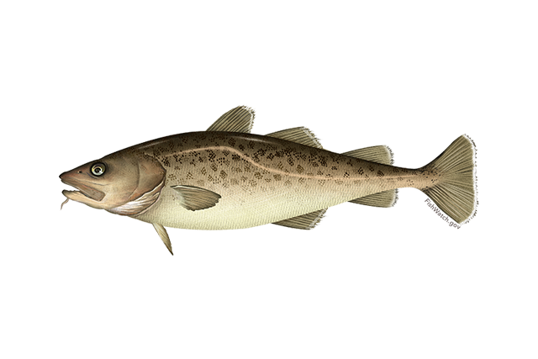

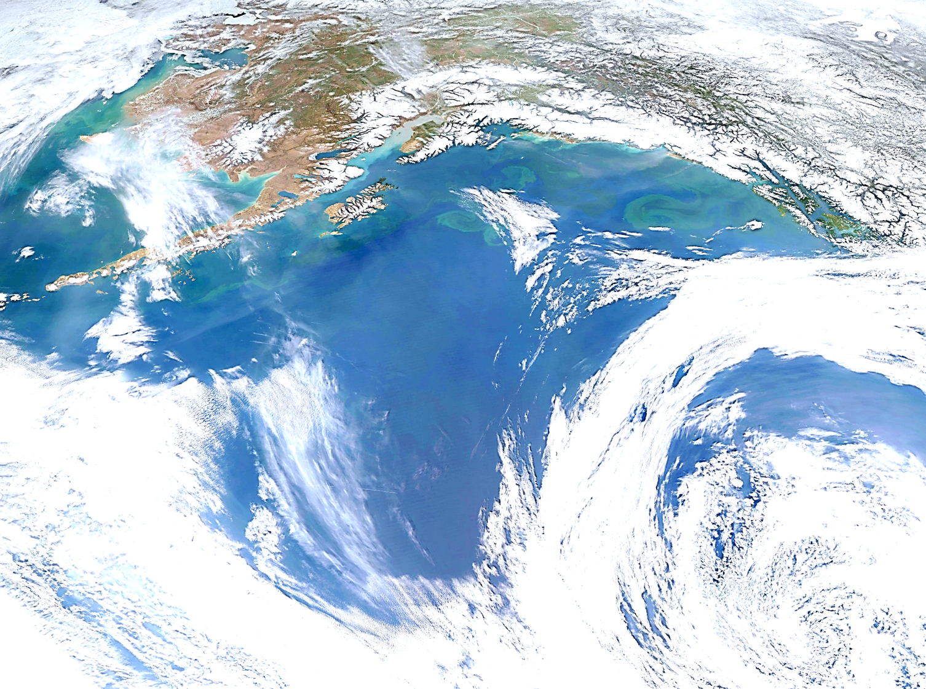
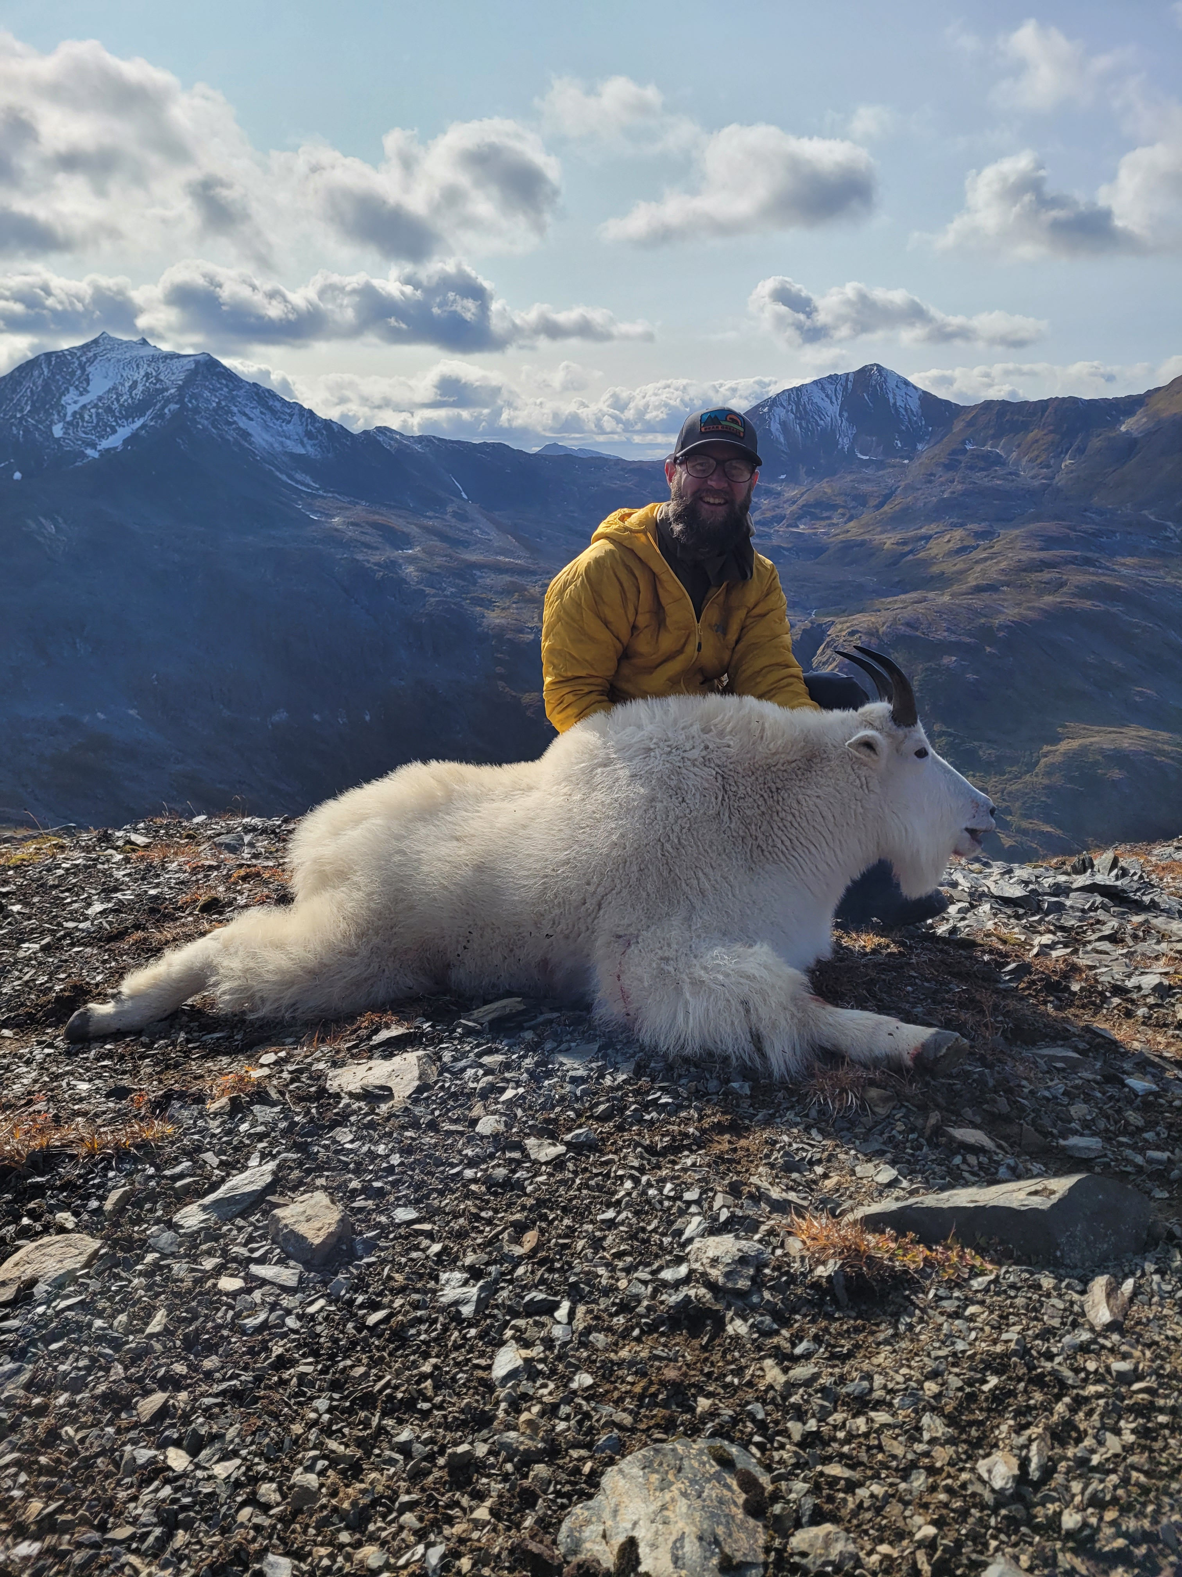

Goa pacific cod
P. hulson, s. barbeaux, b. ferriss, k. echave, J. Nielsen, S. McDermott, b. laurel, a. abookire, Ingrid spies, and s. k. shotwell
January 2026, Presentation to the GOA Plan Team

Slide 2
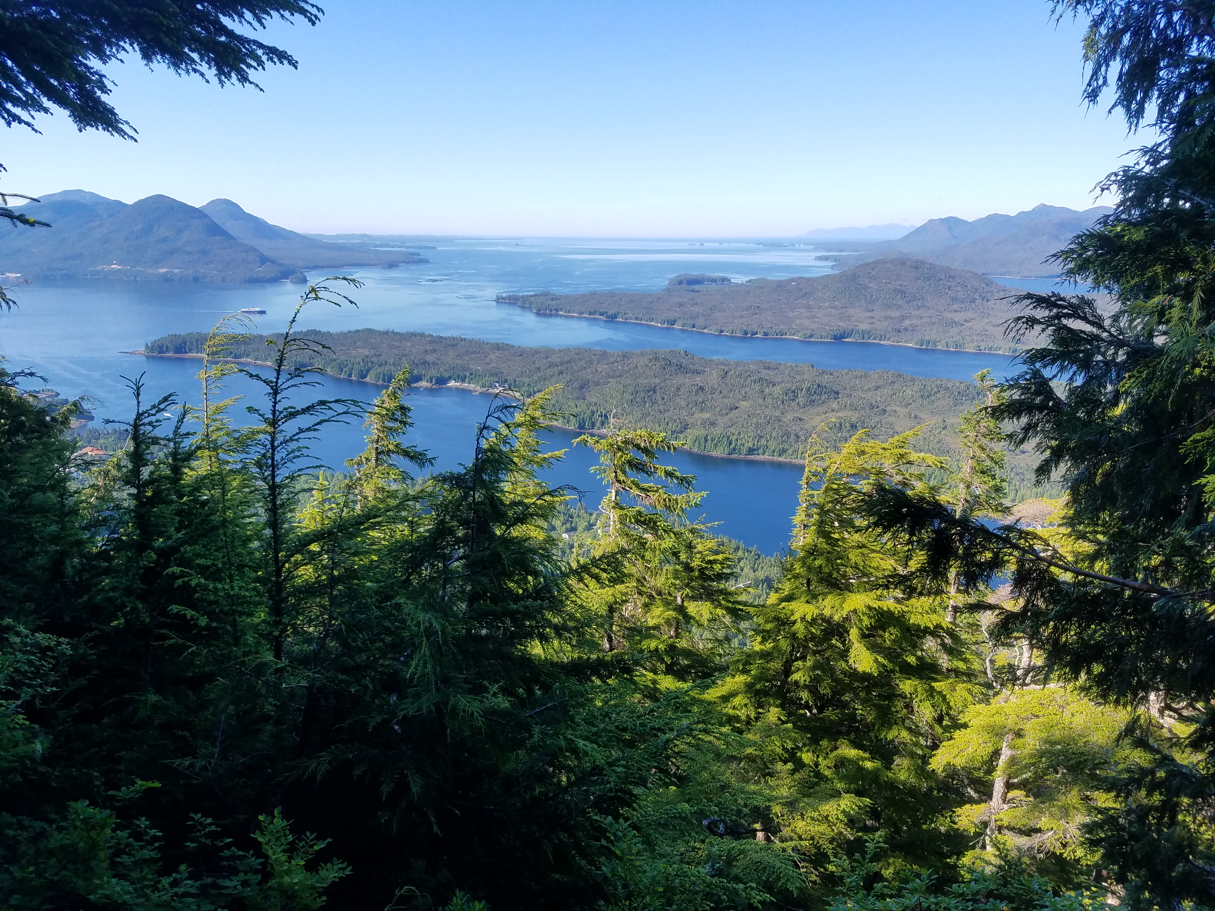
Assessment overview
BLUF:
GOA Pacific cod: Tier 3b
2025 estimated spawning biomass to be at B_{34.3%}, projected in 2026 to be at B_{33.1%}
2026 recommended ABC 29% increase from 2025 ABC
Do not recommend reduction from maximum ABC
Outline:
Updated assessment overview
Updated data through 2025
Model results
ABC/BRD recommendations

Slide 3
Updated assessment overview
2025/2026 GOA Pacific cod is an update assessment
Only new data through 2025 included, no model changes
Abbreviated SAFE document
Only sections that have been updated with new information since 2024 assessment included
Any missing sections (e.g., full Introduction) can be found in the 2024 SAFE
SSC/PT comments and responses not included, will be included and addressed in the next full assessment

Slide 4

Assessment evaluation Outline
Data
Fishery
Results
Data fit
Recommendations
Risk Table
Survey
Other
Model evaluation
Model estimates
ABC/OFL
BRD

Slide 5

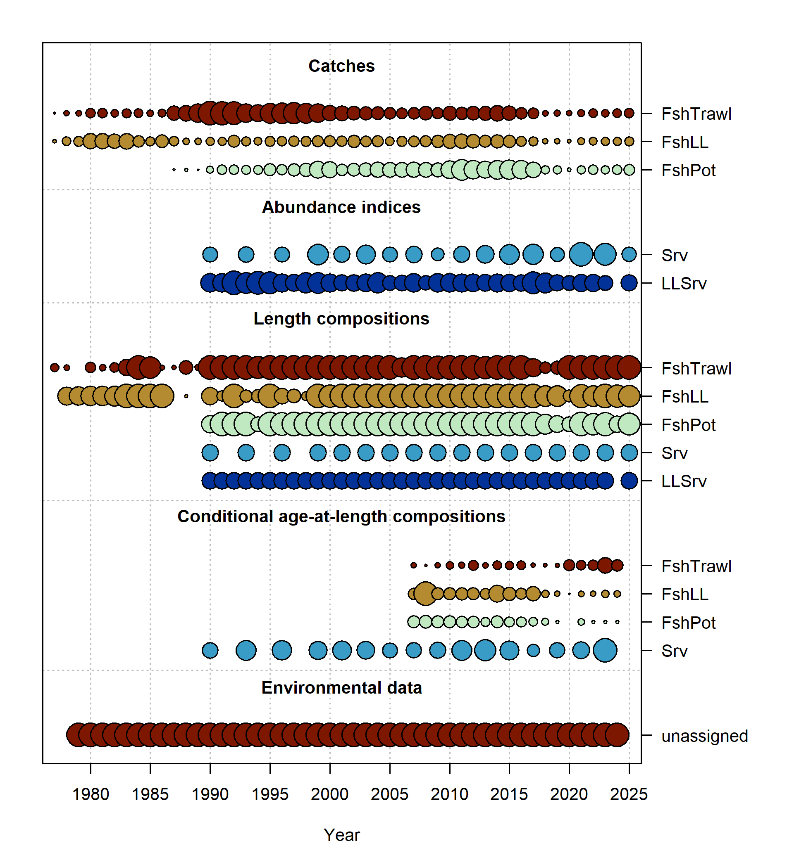
Data overview
New Data | Years
Federal and state fishery catch, by gear type | 2024, 2025
Federal and state fishery length composition, by gear type | 2024, 2025
Federal fishery conditional age-at-length | 2024
GOA AFSC bottom trawl survey abundance | 2025
GOA AFSC bottom trawl survey length composition | 2025
GOA AFSC longline survey Relative Population Numbers | 2025
GOA AFSC longline survey length composition | 2025

Slide 6
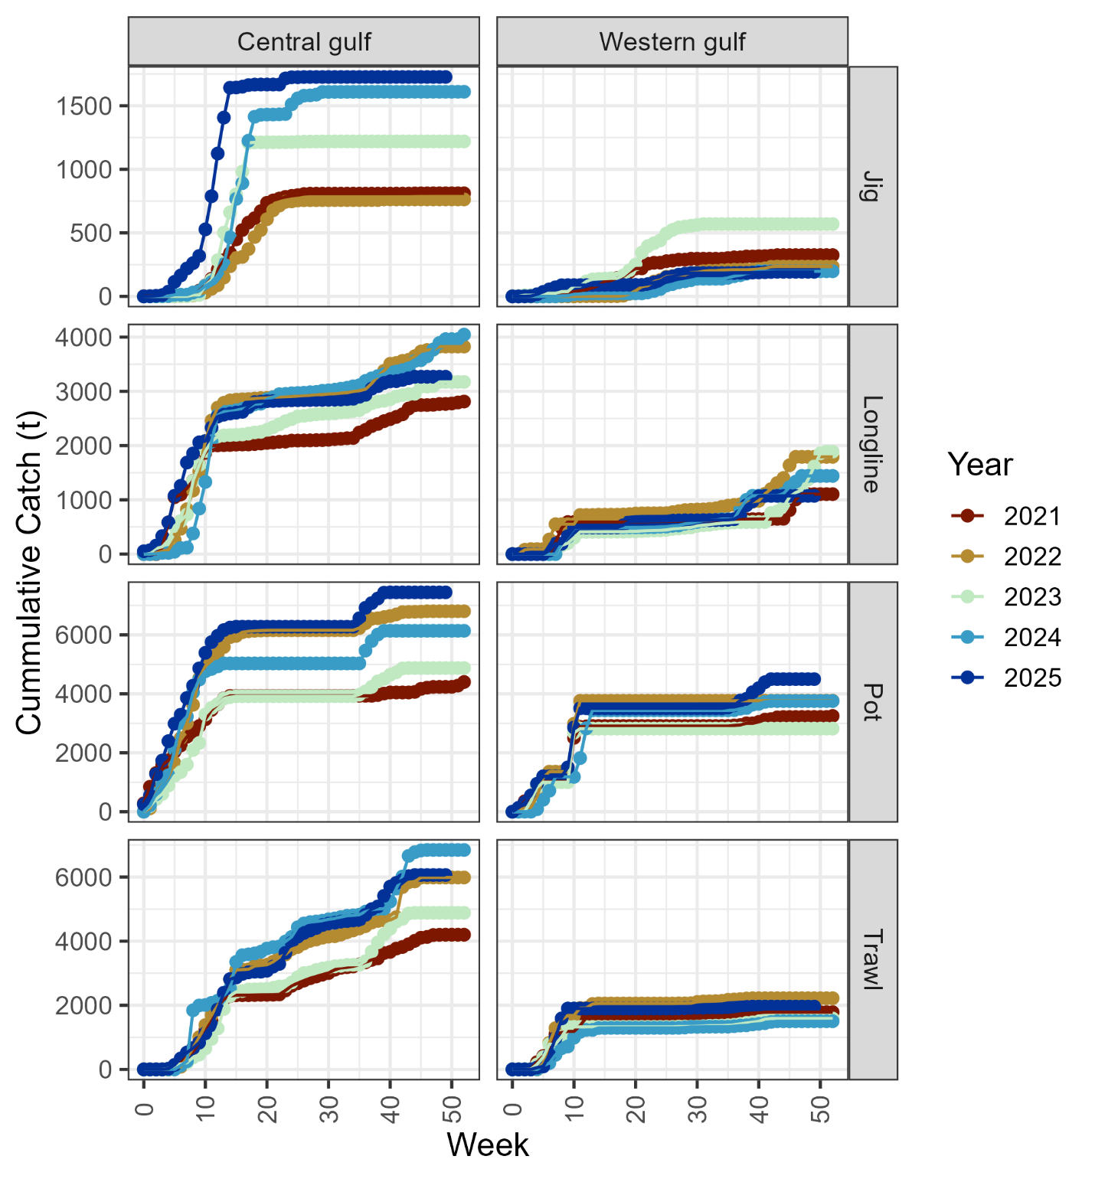
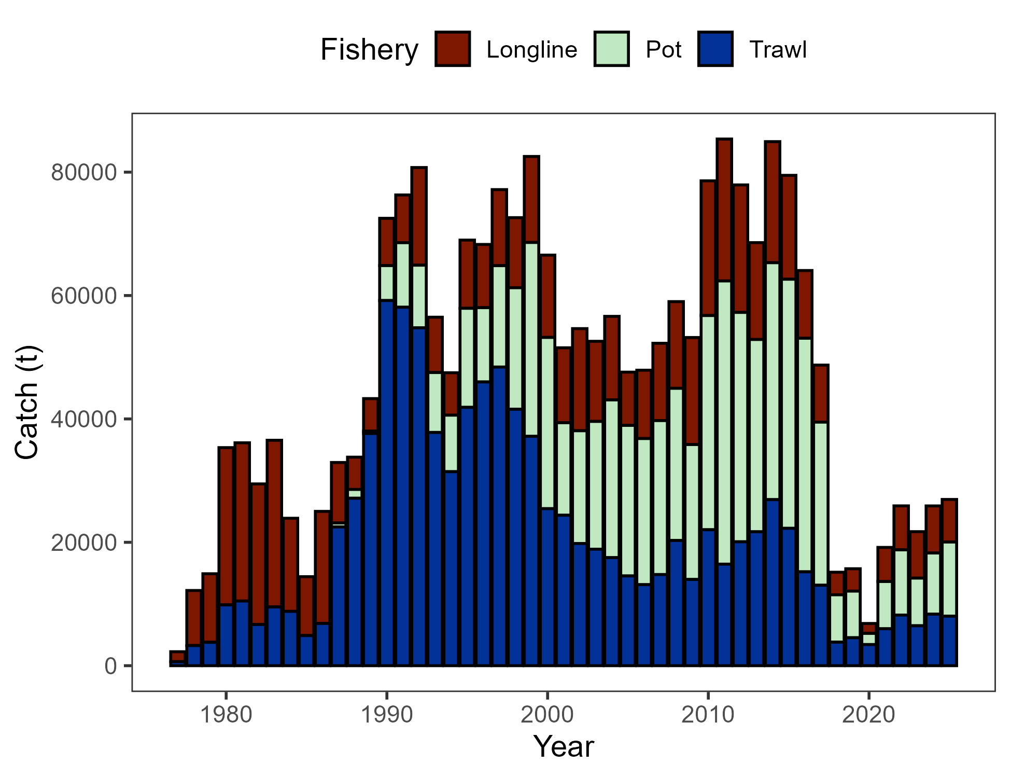
Data - Catch
Pot majority > LL > Trawl
Nothing inconsistent in cumulative catch to previous years
Catch through Dec 8, 2025

Slide 7
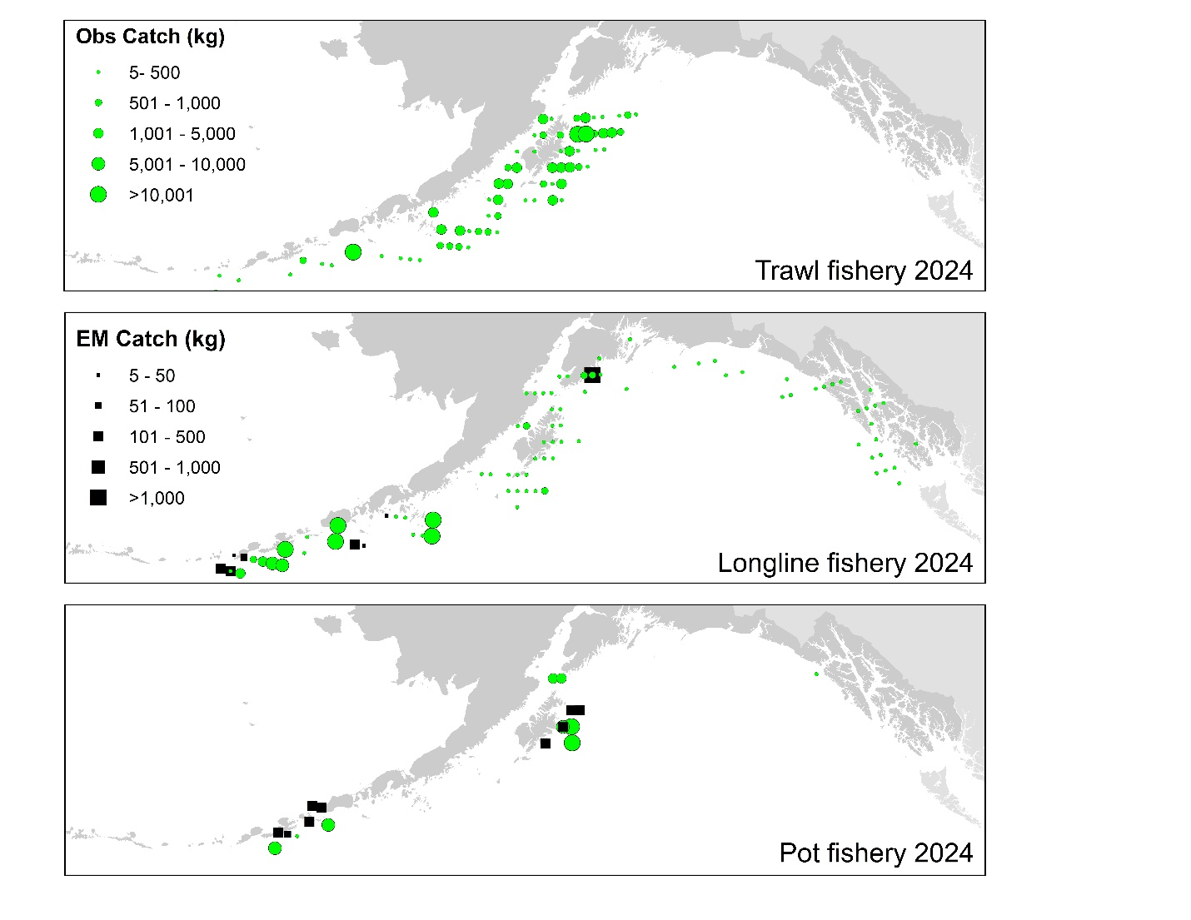
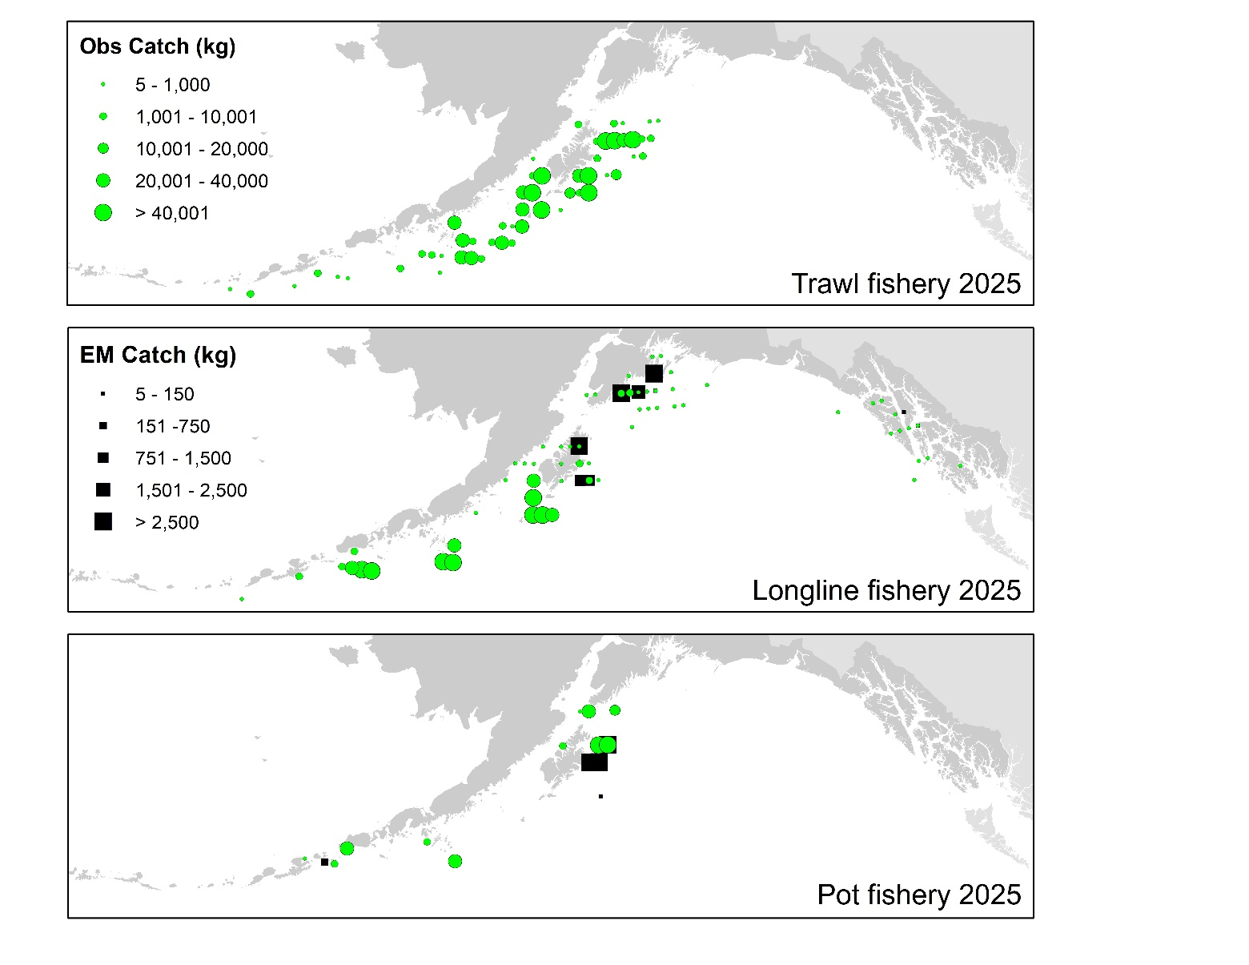
Data – Catch distribution
2025 distribution similar to previous catch distribution
For how much relative catch is taken by pot, small # observed hauls

Slide 8
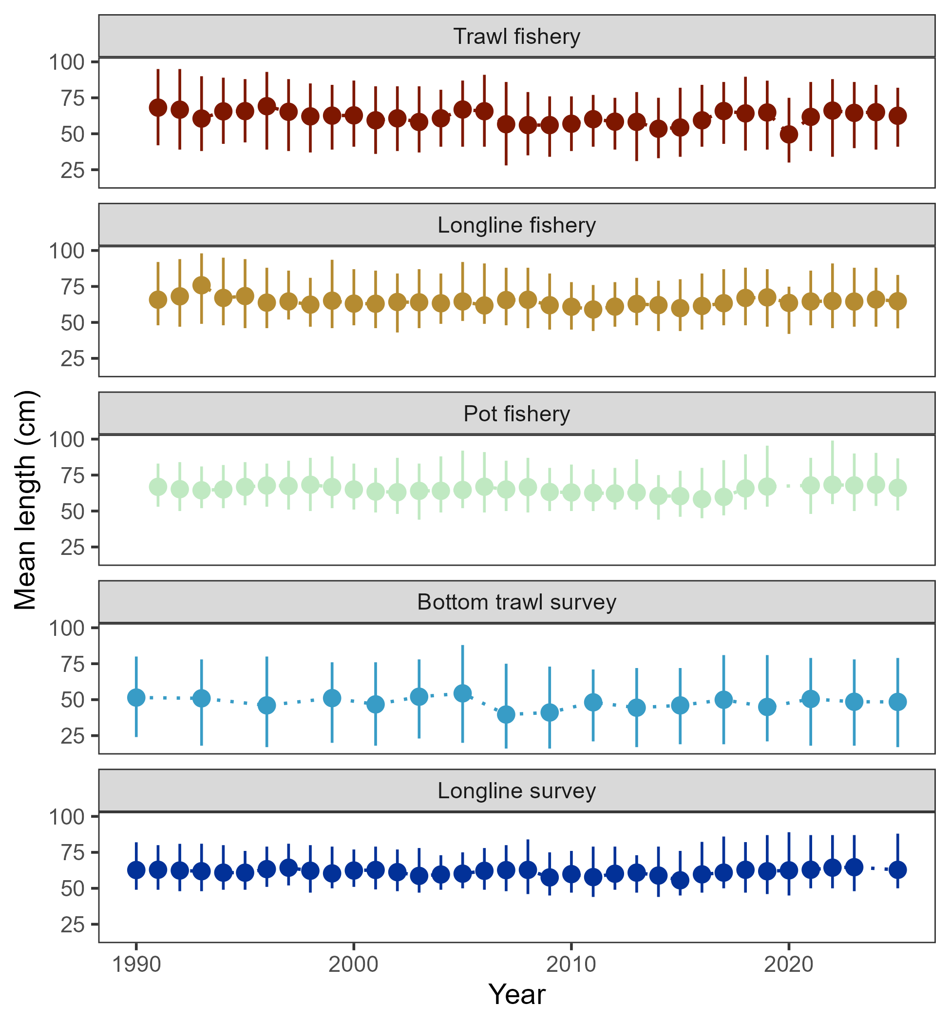
Data – length comps
In general, mean length in 2024 similar to that in previous 4 or so years

Slide 9
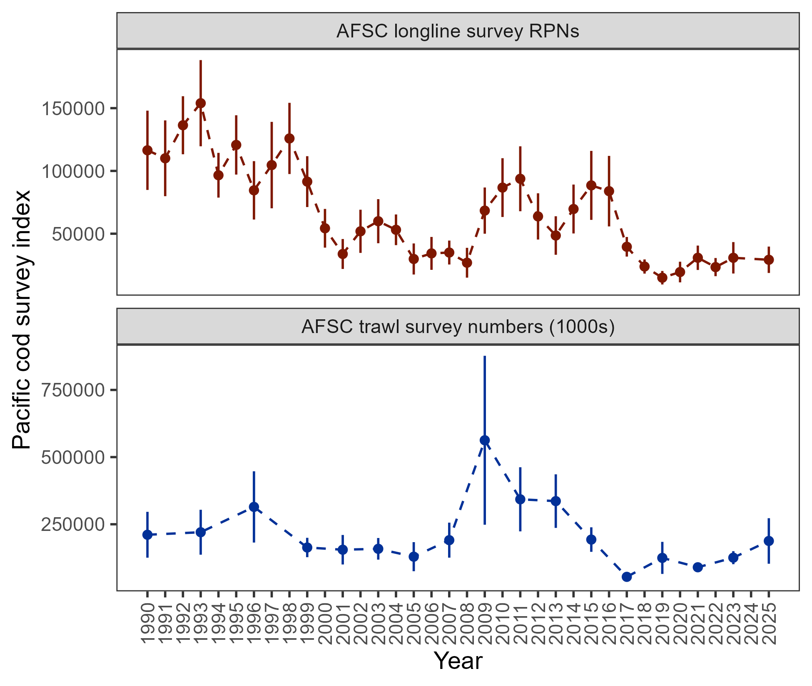
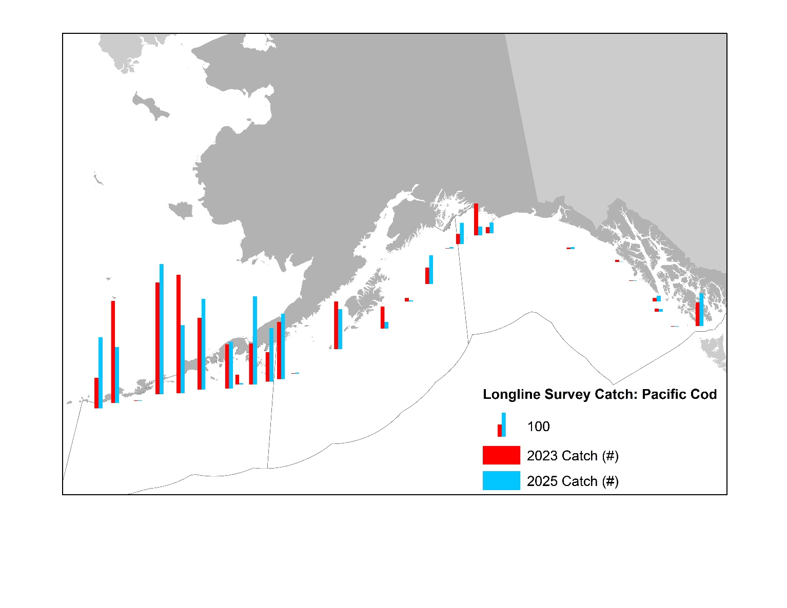
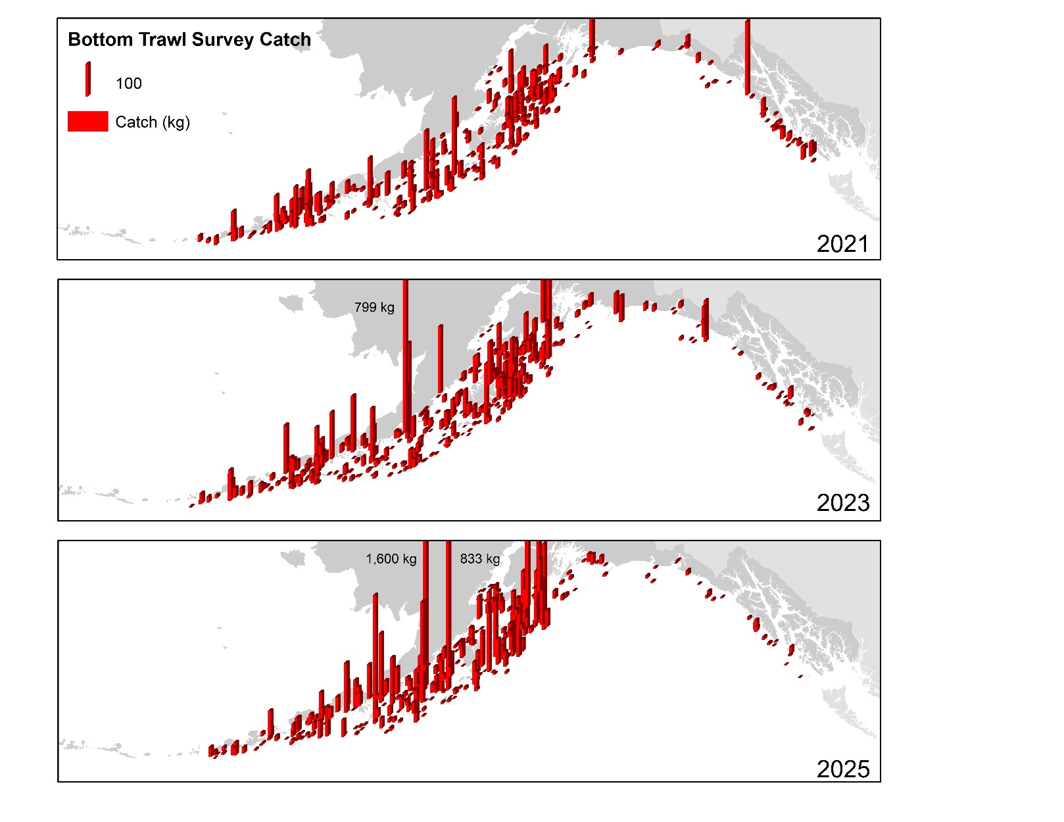
Data – afsc surveys
-5%
+49.6%

Slide 10
Data – afsc surveys
For a moment, taking a detour to put context in the survey results
Why was there an observed decline in longline survey RPNs?
Was there an influence of the GOA bottom trawl survey restratification on 2025 results?

Slide 11
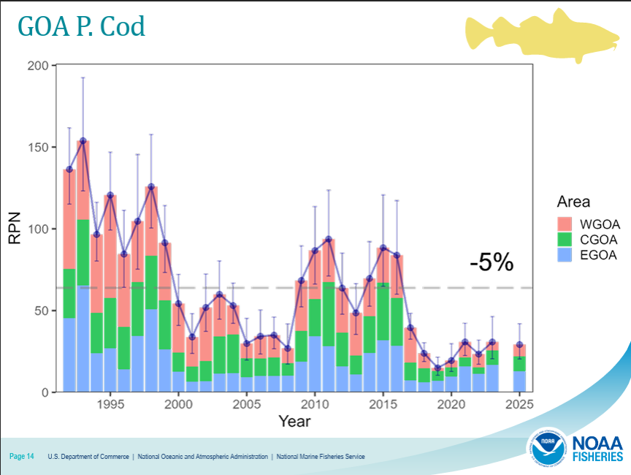
Data – afsc surveys
Why was there an observed decline in longline survey RPNs?
Subregion change since 2023: WGOA +40%, CGOA +4.8%, EGOA -23.6%
This decline in RPN due to influence of EGOA RPN, which is 44% of total GOA RPN

Slide 12
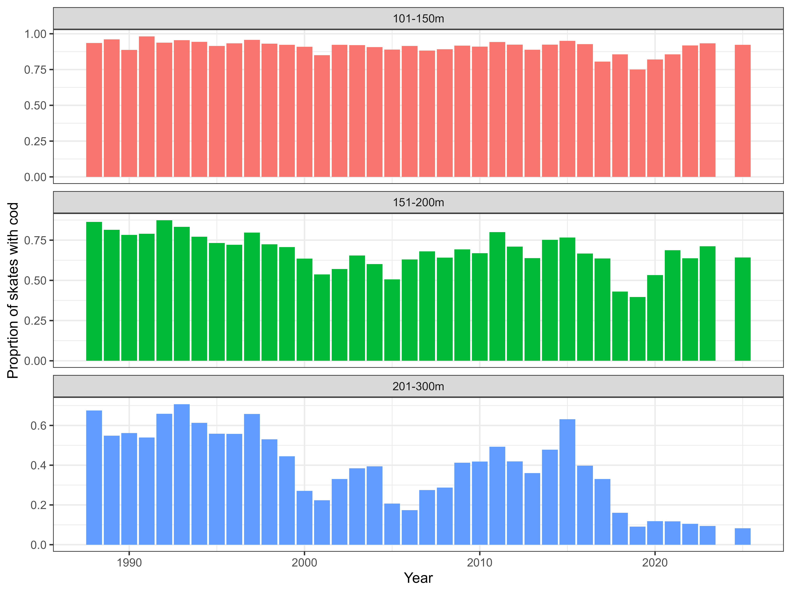
Data – afsc surveys
Why was there an observed decline in longline survey RPNs?
Drilling down into EGOA: Decline from 2025 due to single station
Why is EGOA RPN so large?
44% of GOA RPN whereas the AFSC bottom trawl survey observes <10% of cod pop’n in GOA resides
RRN calculated for depths start at 150m: Area size for 150-200m strata in EGOA as compared to CGOA-WGOA is much larger causing disproportionate effect on calculated RPNs

Slide 13
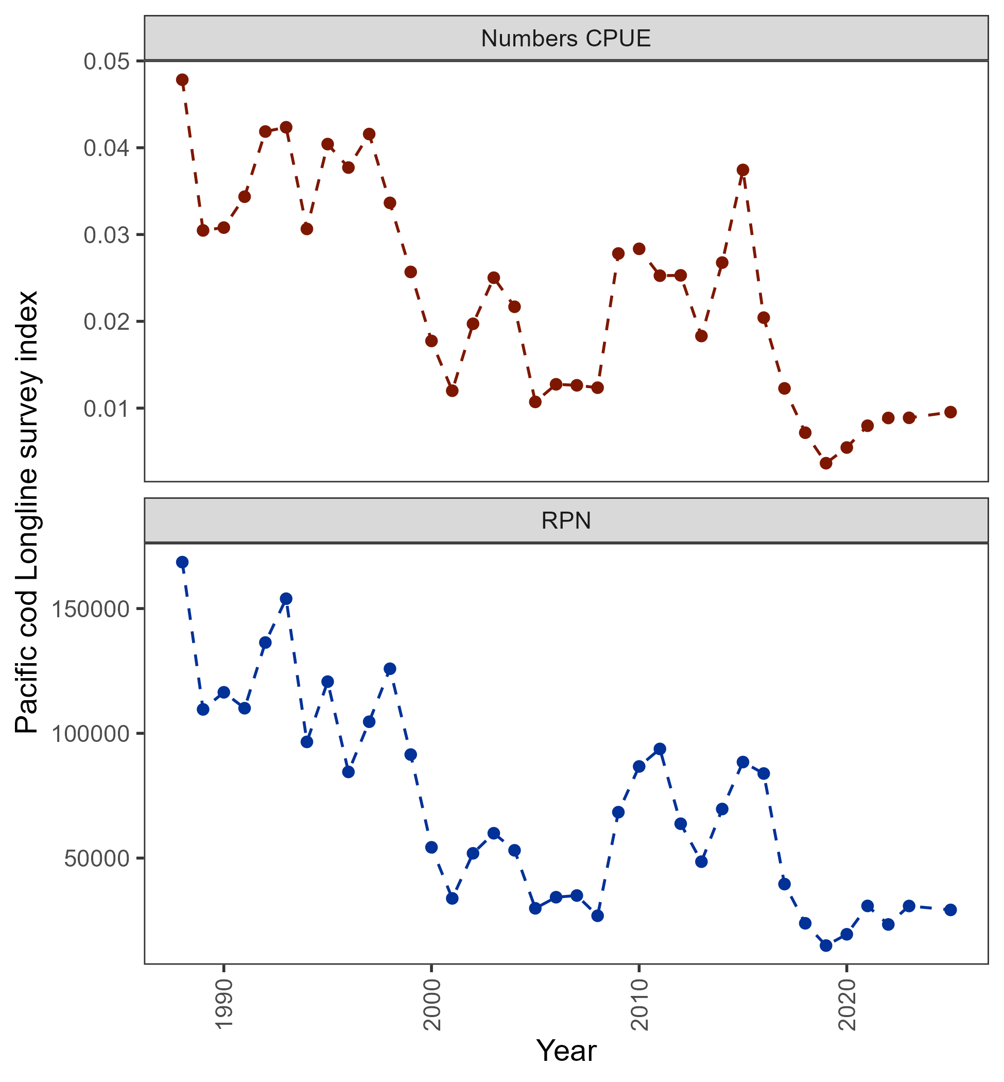
Data – afsc surveys
While 5% decrease in RPN index, raw numbers CPUE increased by more than 7%
Prior to next full assessment we will be reevaluating how GOA Pacific cod RPN index computed
+7.4%
-5%

Slide 14
Data – afsc surveys
Was there an influence of the GOA bottom trawl survey restratification on 2025 results?
Appendix 2.2:

Slide 15
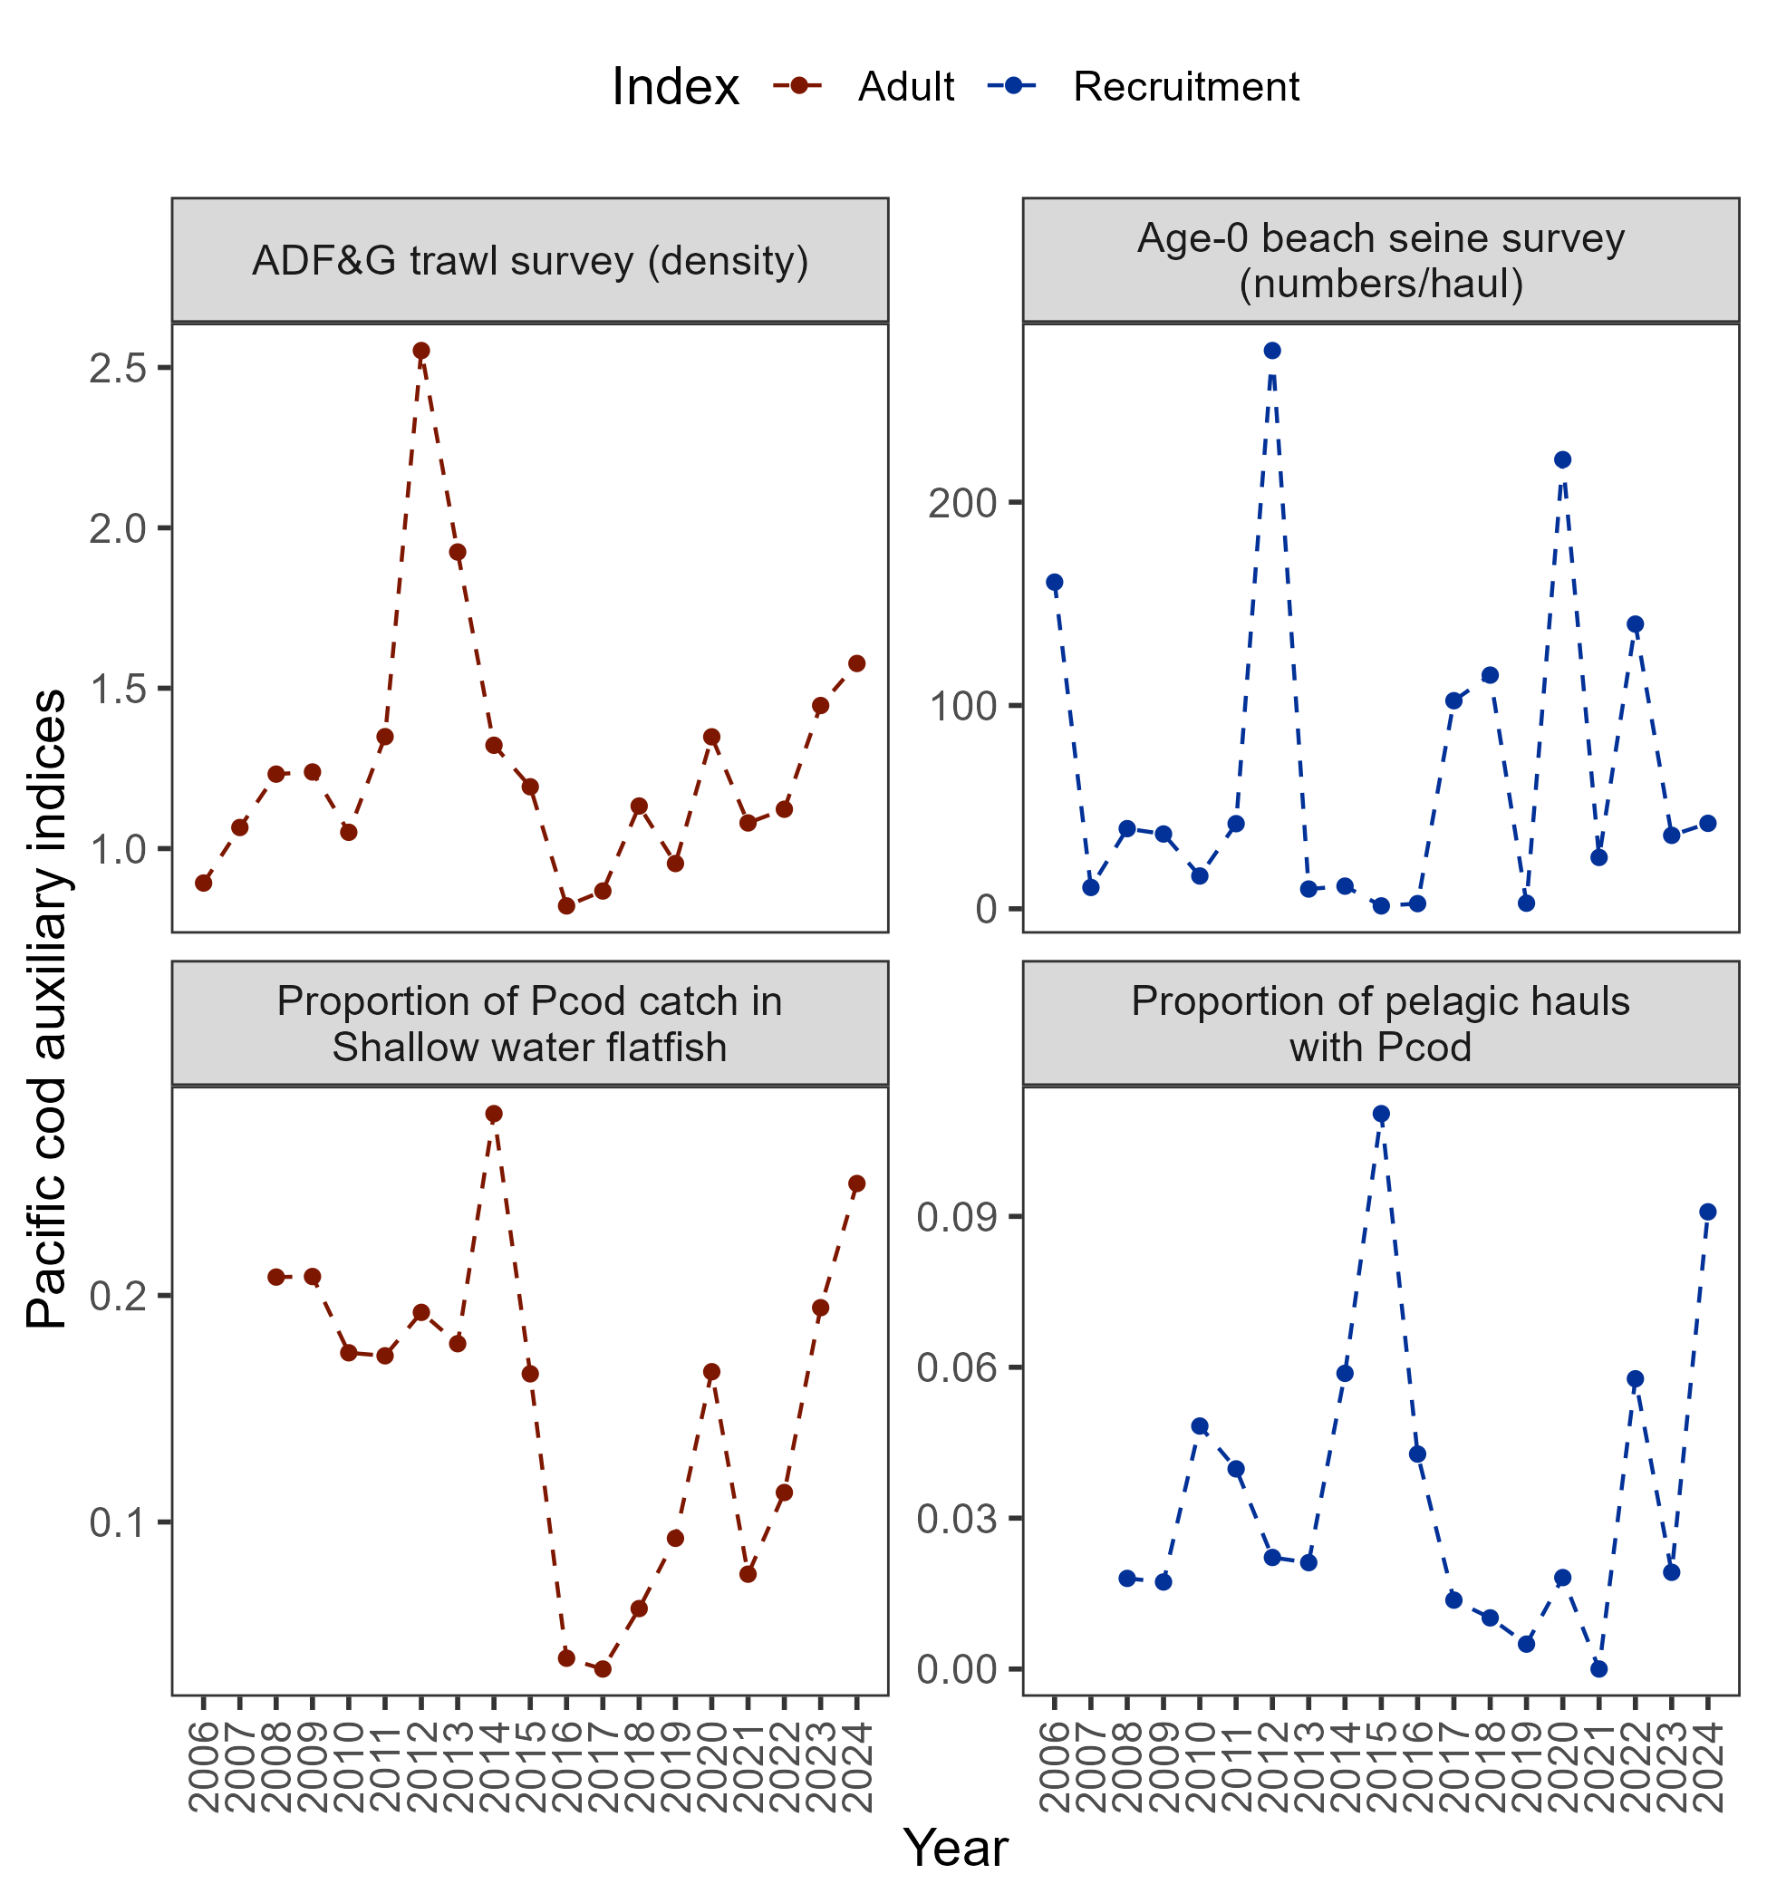
Data – auxiliary information
+9%
+28%

Slide 16

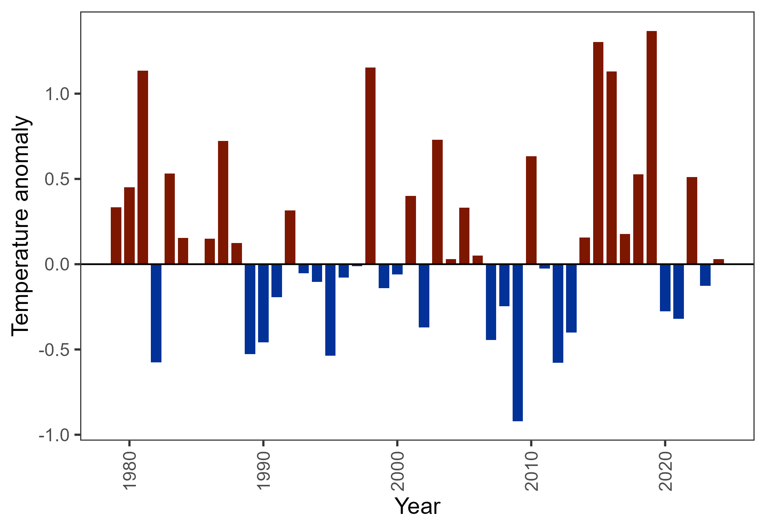
Surveys – Env data
CFSR bottom temperature below mean in 2023, slightly above in 2024

Slide 17
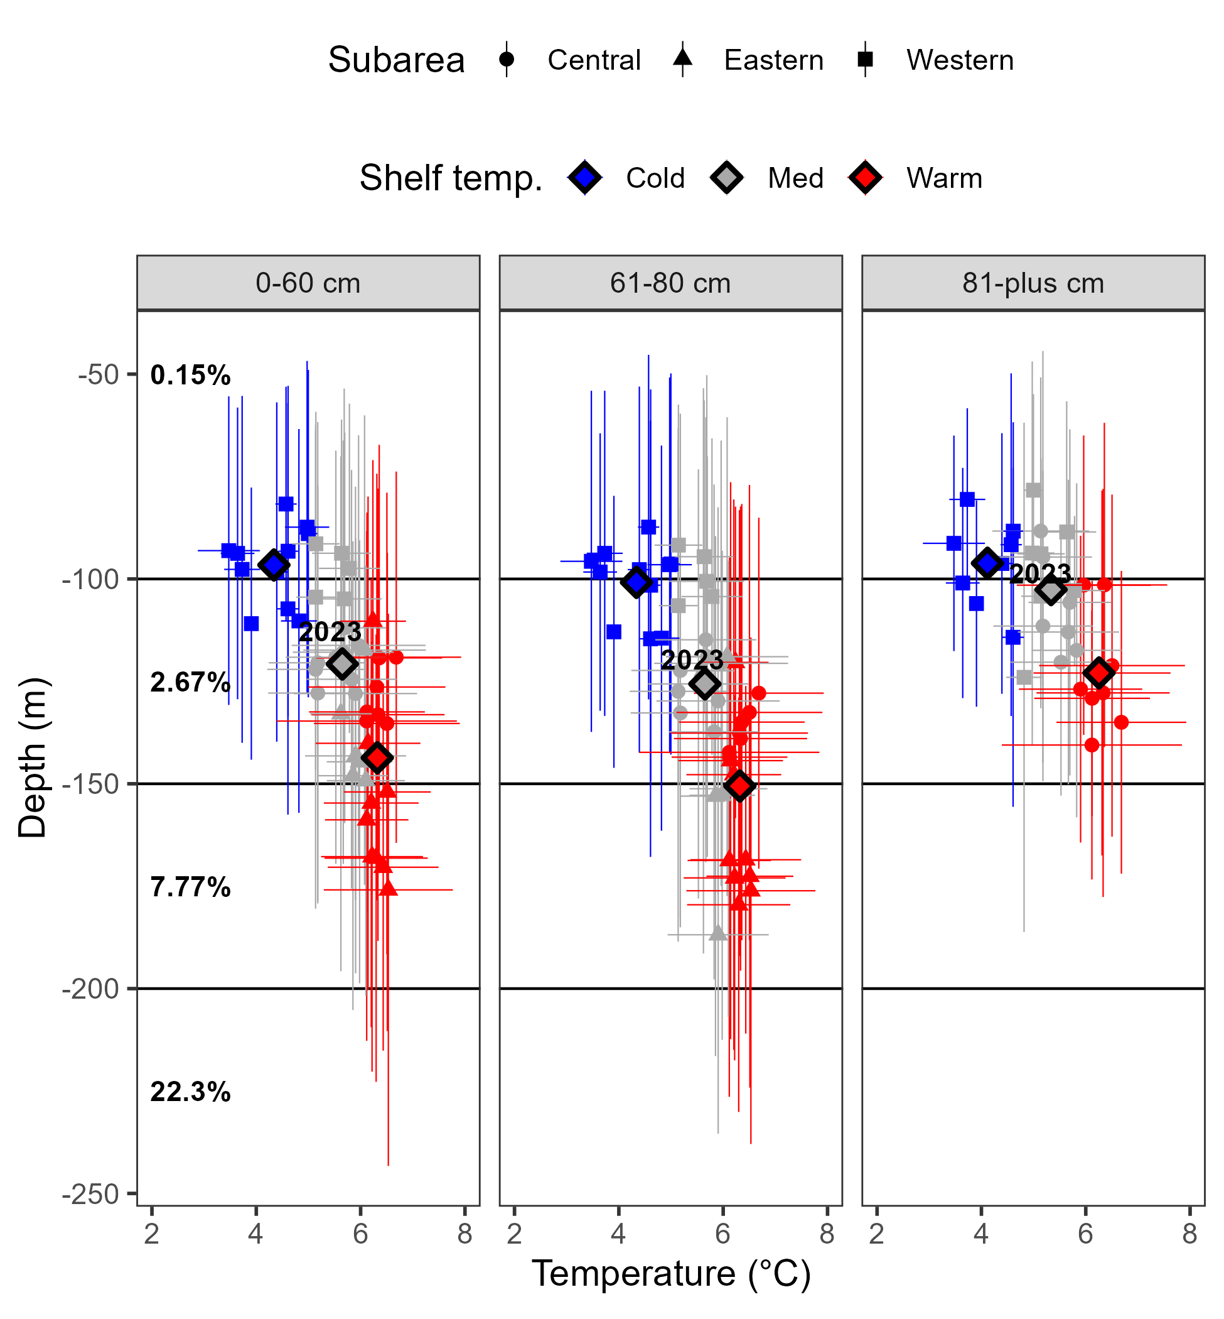
Surveys – Env data
Cod depth distribution related to temperature, variable overlap with AFSC longline survey distribution

Slide 18
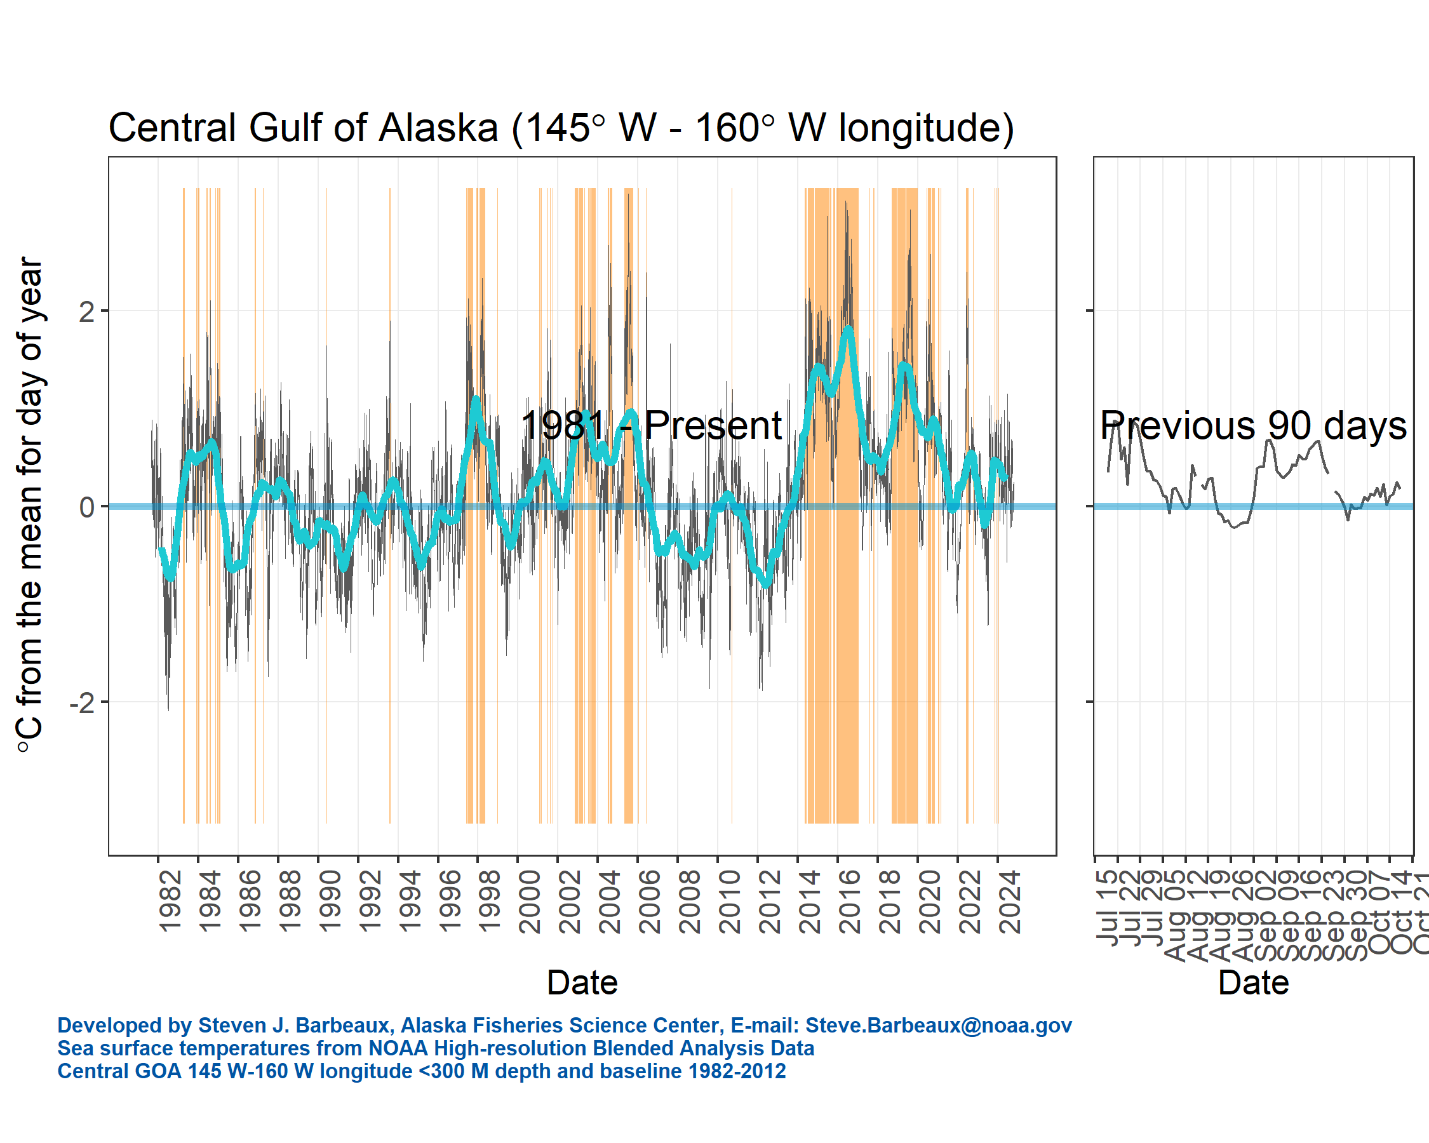
Surveys – Env data
Above avg sea surface temperature, but not like seen before

Slide 19
Data – summary
Length comp trends:
No red flags, recent lengths consistent
Index trends:
Environmental trends:
2024 average year, no red flags
Available auxiliary sources increased in 2024

Slide 20
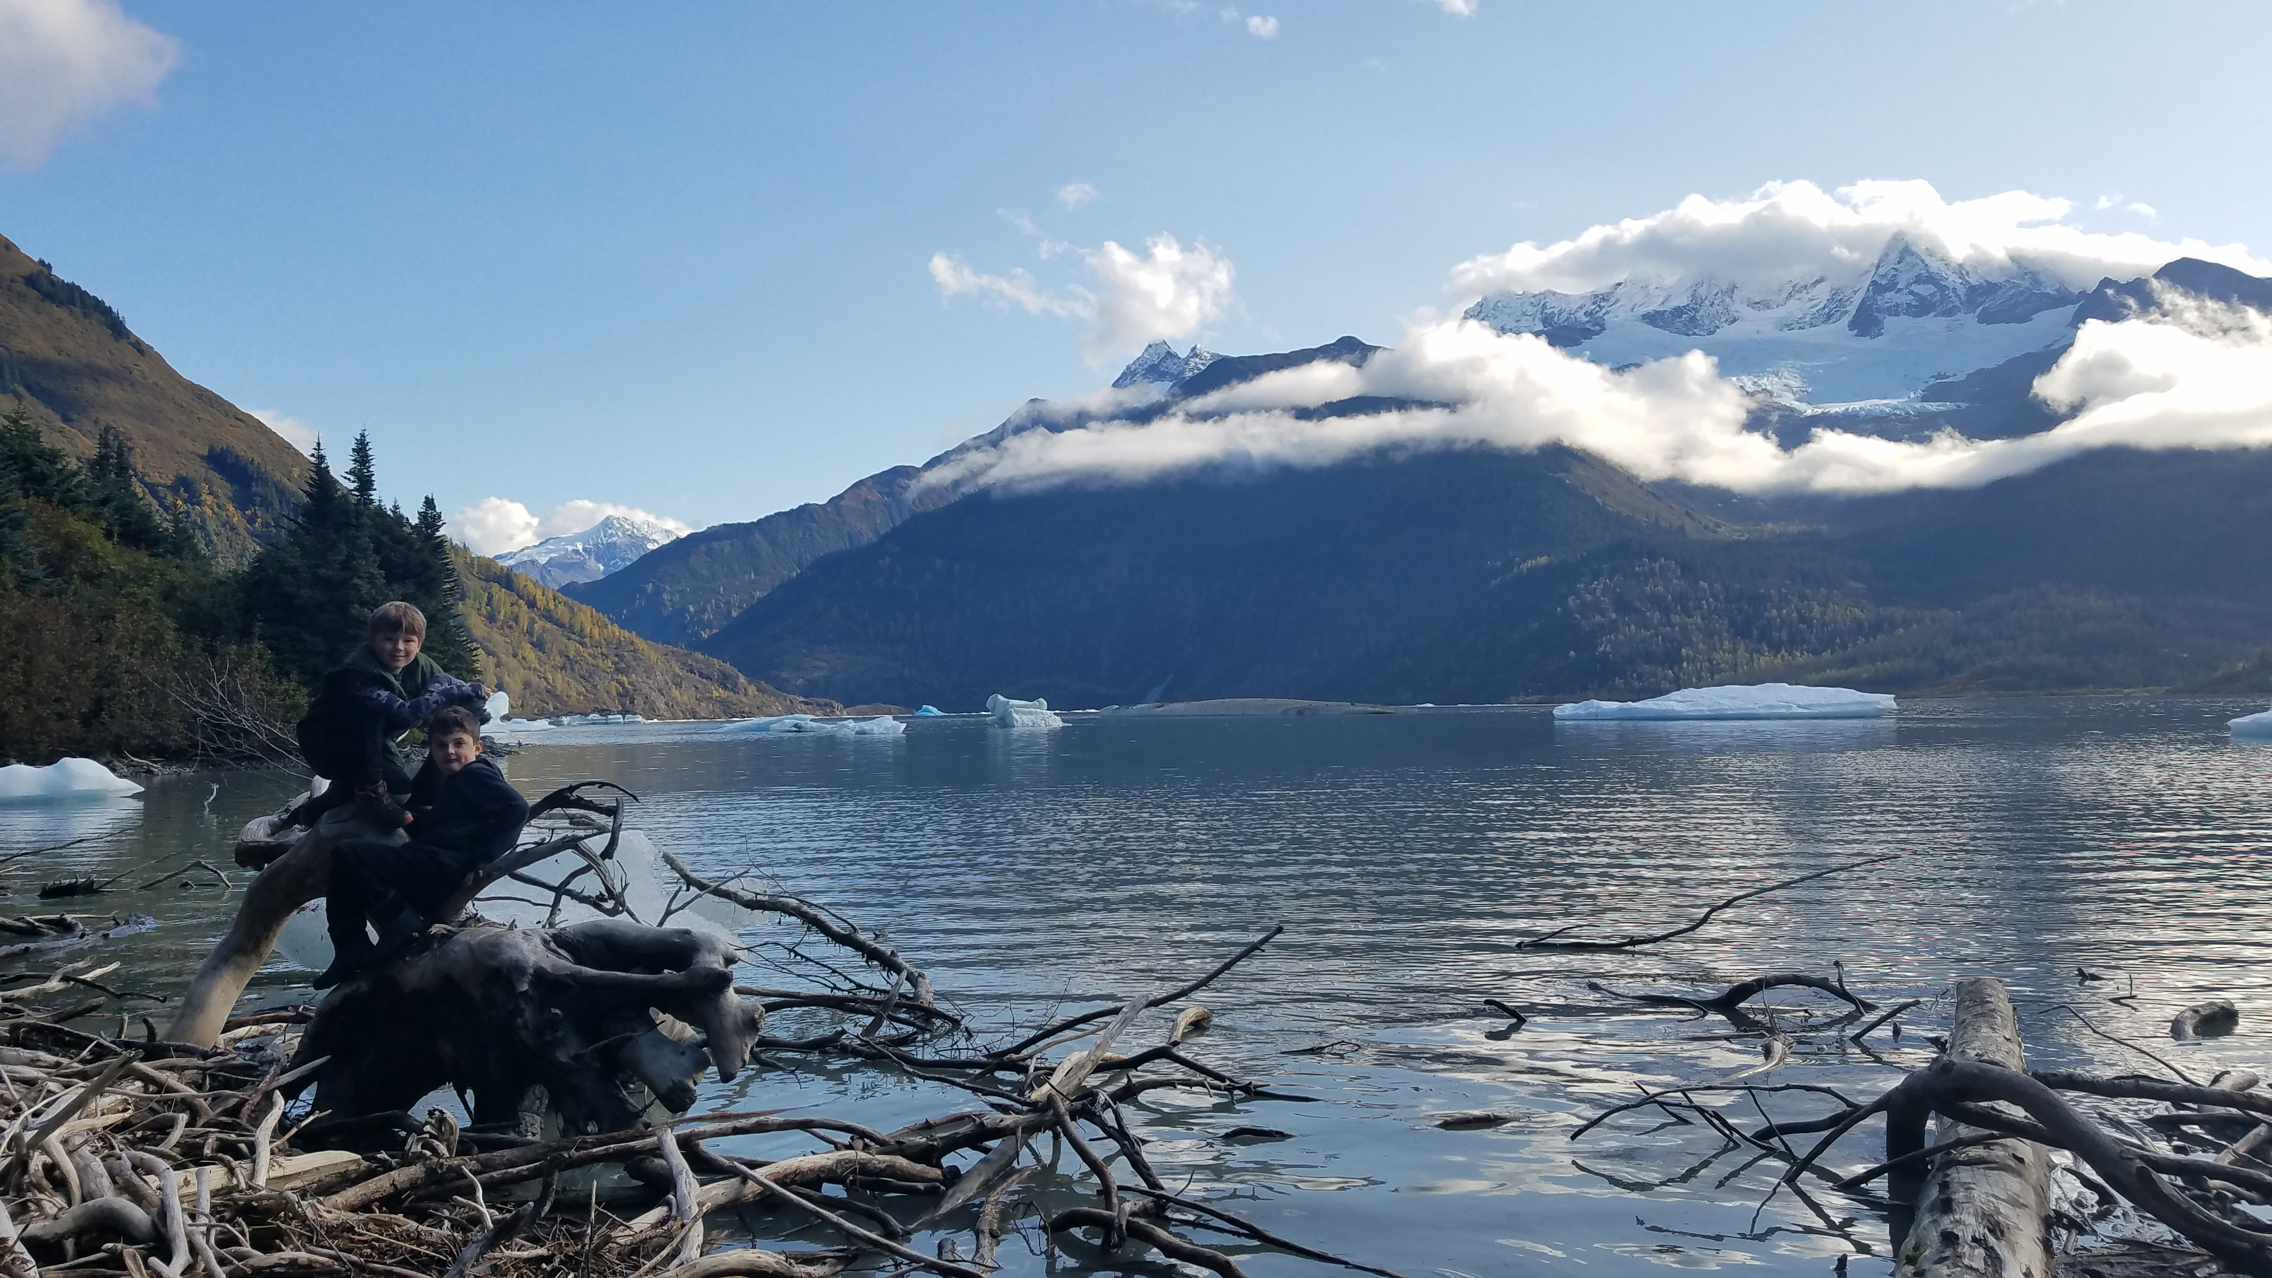
results
Alternative model comparison
Data fits
Parameter/Time series results
Model diagnostics
Recommendations

Slide 21
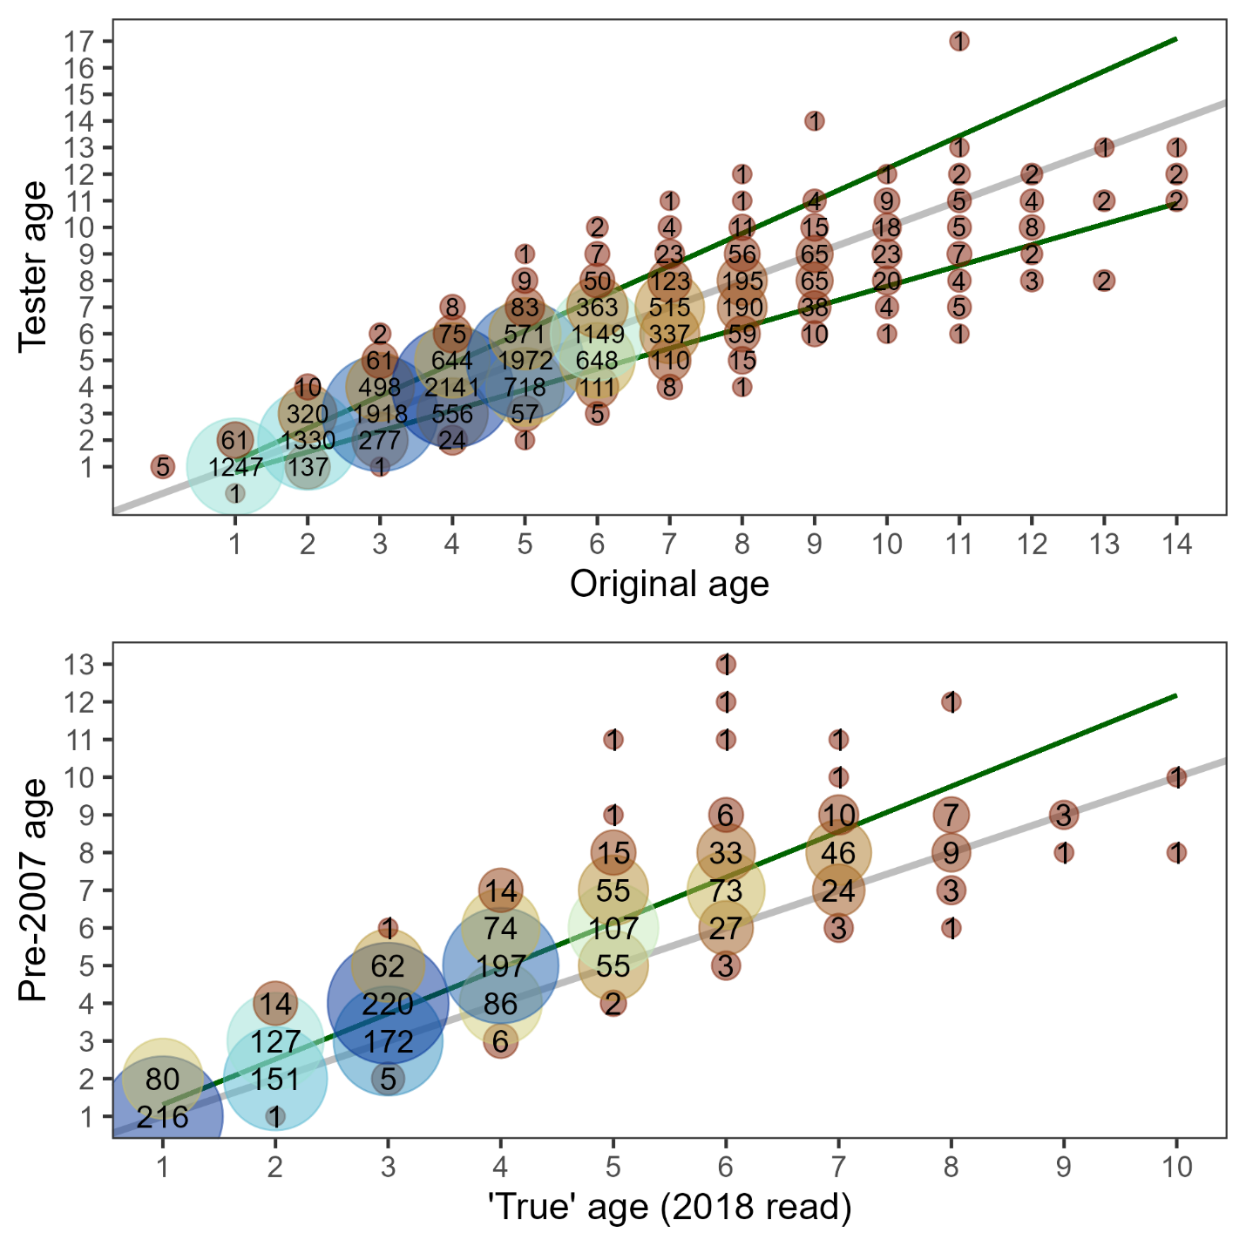
Results: alt. models
19.1c: input file corrections (Appendix 2.2)
19.1d: update ageing error & bias (AgeingError)
Combined EBS & GOA
Linear (AIC pref): start at age-1
Bias fixed rather than estimated

Slide 22
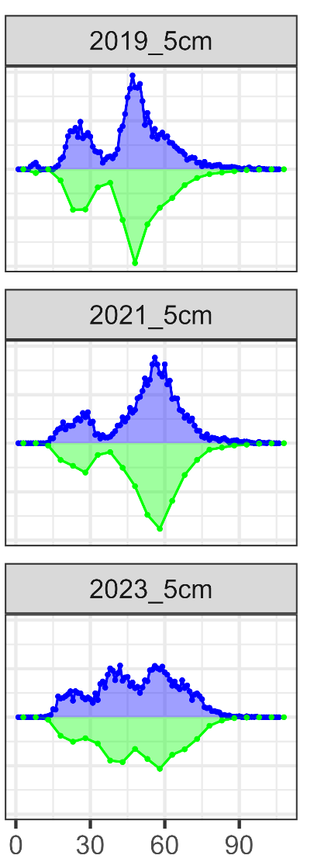
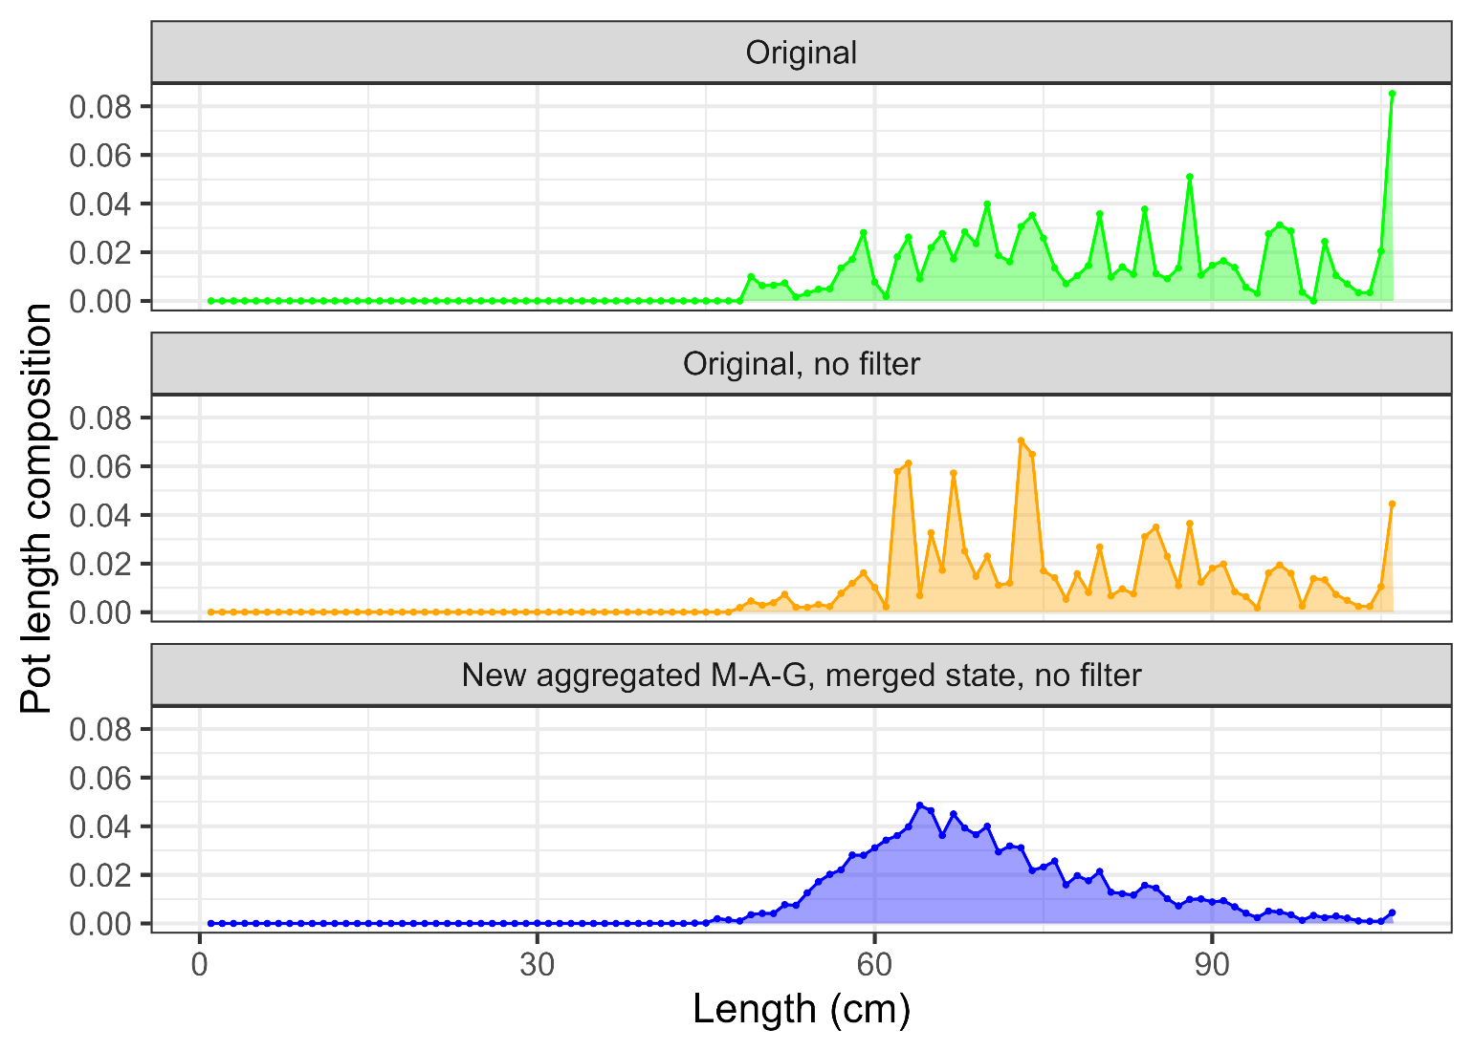
Results: alt. models
19.1d: new method to compute fishery length comps:
Weekly → Monthly
Use all ADF&G data
Remove filters
24.0: 1 → 5 cm bins

Slide 23
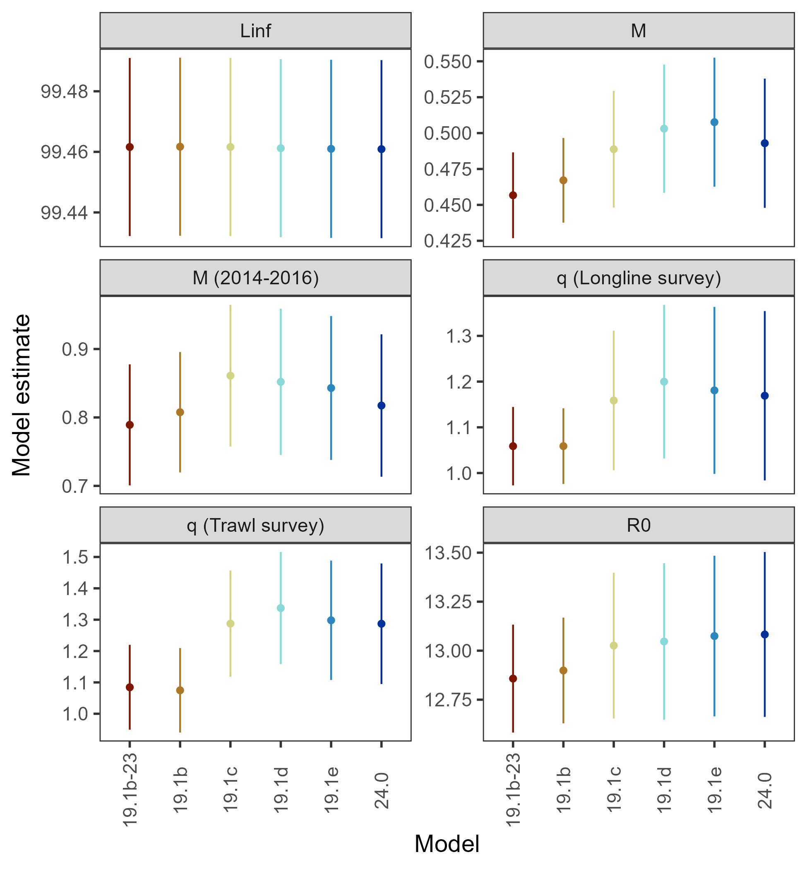
Results: alt. models
Largest shift in parameter estimates occurred in the 19.1c transition

Slide 24
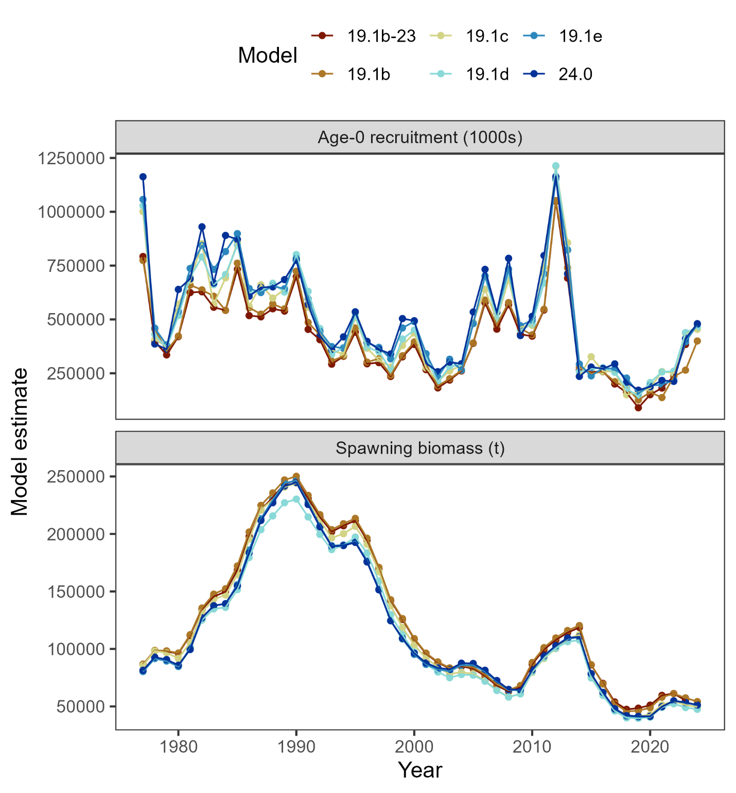
Results: alt. models
In general, consistent estimates of recruitment & spawning biomass

Slide 25
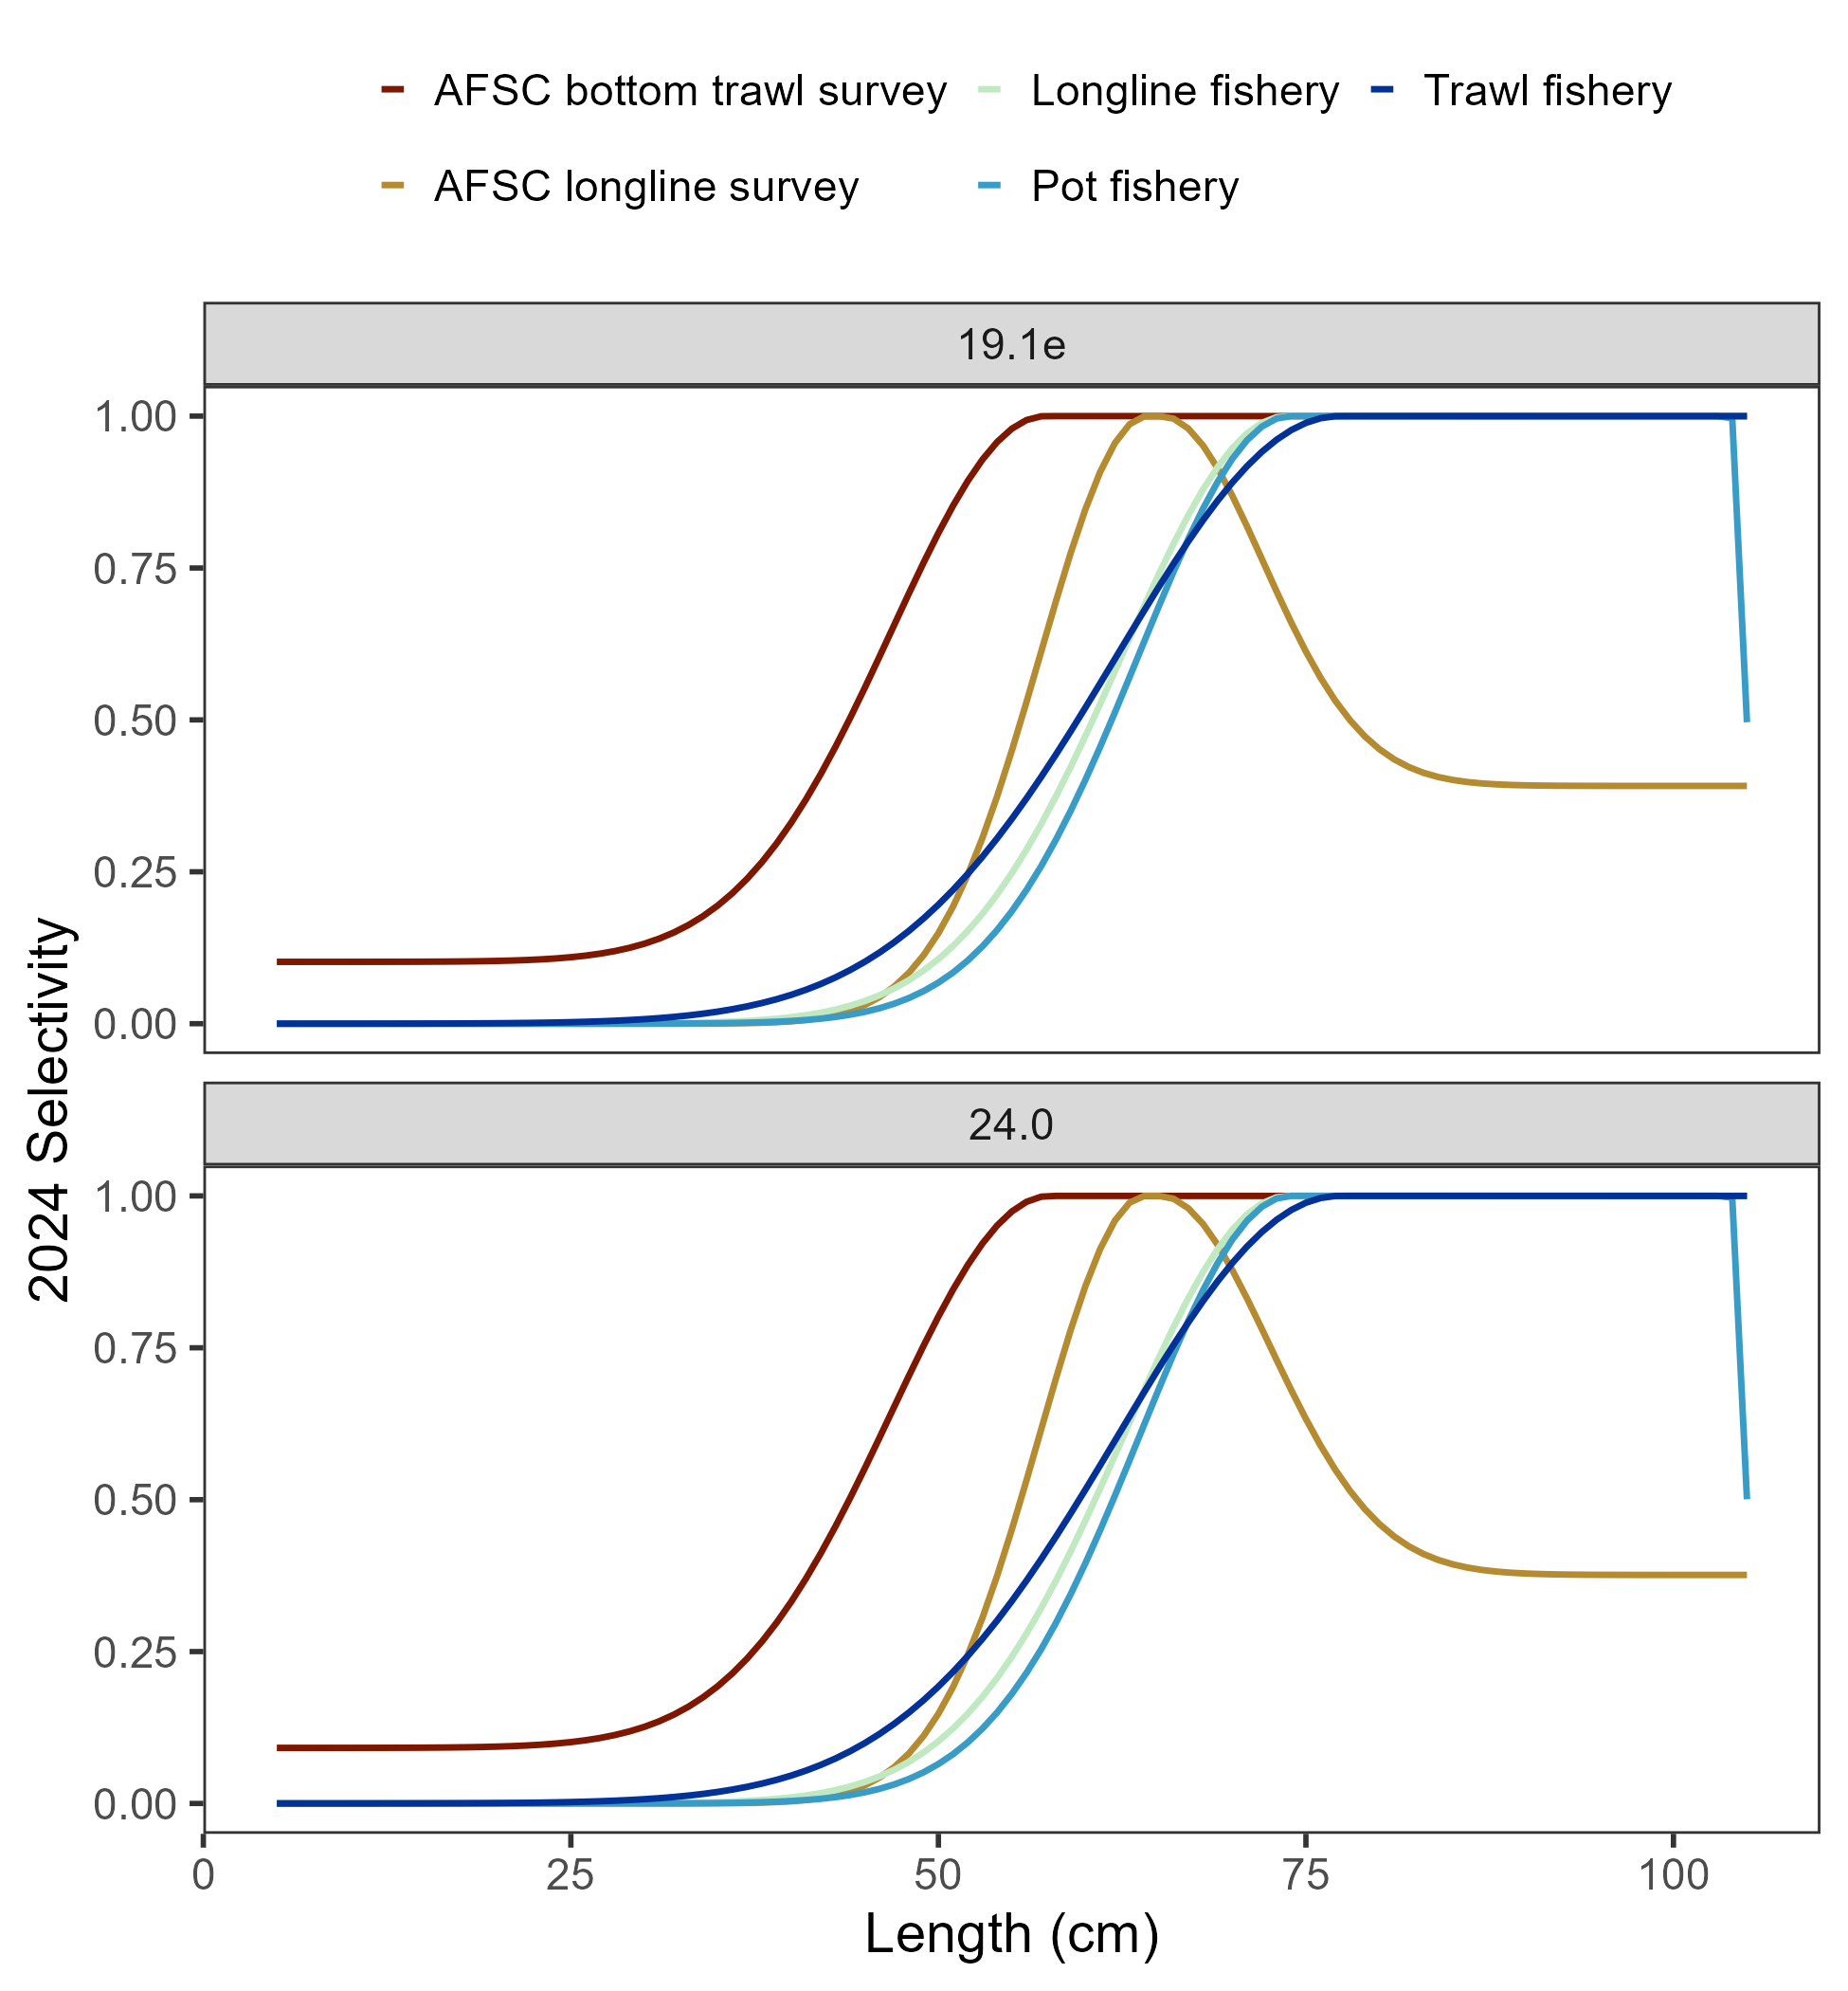
Results: alt. models
No discernable difference in, for example, selectivity when shifting from 1 → 5 cm bins
But, improvement in ISS/ESS
Component | 19.1b-23 | 19.1b | 19.1c | 19.1d | 19.1e | 24.0
Length composition mean ISS/ESS | 0.35 | 0.35 | 0.33 | 0.33 | 0.33 | 1.41
Trawl fishery | 0.35 | 0.37 | 0.33 | 0.33 | 0.33 | 1.43
Longline fishery | 0.26 | 0.26 | 0.25 | 0.25 | 0.26 | 1.04
Pot fishery | 0.5 | 0.48 | 0.46 | 0.47 | 0.45 | 2.06
Bottom trawl survey | 0.32 | 0.31 | 0.31 | 0.3 | 0.31 | 1.18
Longline survey | 0.35 | 0.35 | 0.32 | 0.32 | 0.33 | 1.31
Conditional age-at-length mean ISS/ESS | 0.35 | 0.37 | 0.29 | 0.32 | 0.32 | 0.83
Trawl fishery | 0.42 | 0.42 | 0.28 | 0.29 | 0.27 | 0.6
Longline fishery | 0.4 | 0.41 | 0.27 | 0.27 | 0.28 | 0.66
Pot fishery | 0.3 | 0.32 | 0.23 | 0.23 | 0.24 | 0.48
Bottom trawl survey | 0.32 | 0.34 | 0.33 | 0.4 | 0.4 | 1.28

Slide 26
Results: recommended model
19.1c & 19.1d data/model updates
19.1e:
Provides simpler and more efficient method,
serves to smooth variability across lengths,
leverages previously under-used source of information (that is included in total catch).
24.0:
Doesn’t mask any signal in data.
seems to improve statistical attributes of model,
improves model efficiency (reduces run time >50%)

Slide 27
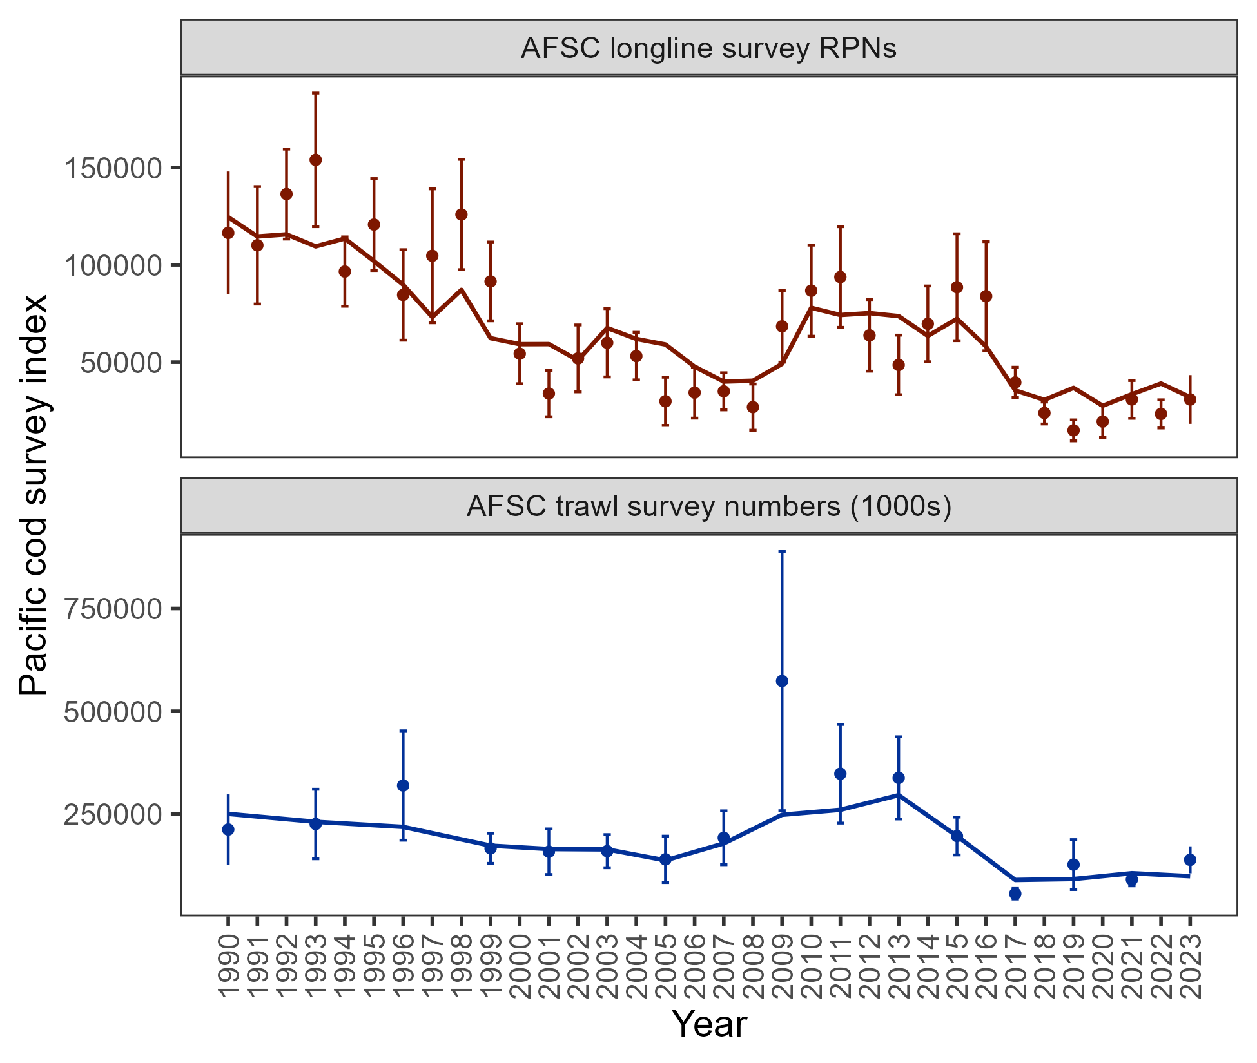
Results: data fits
Pattern of expecting larger RPN from longline survey in 5 of last 6 years, but, model hits 2023
Trawl survey fit between lows in 2017 & 2021 and larger in 2019 & 2023 – model expects less abundance than observed in 2023
Consistent with 2023 assessment

Slide 28
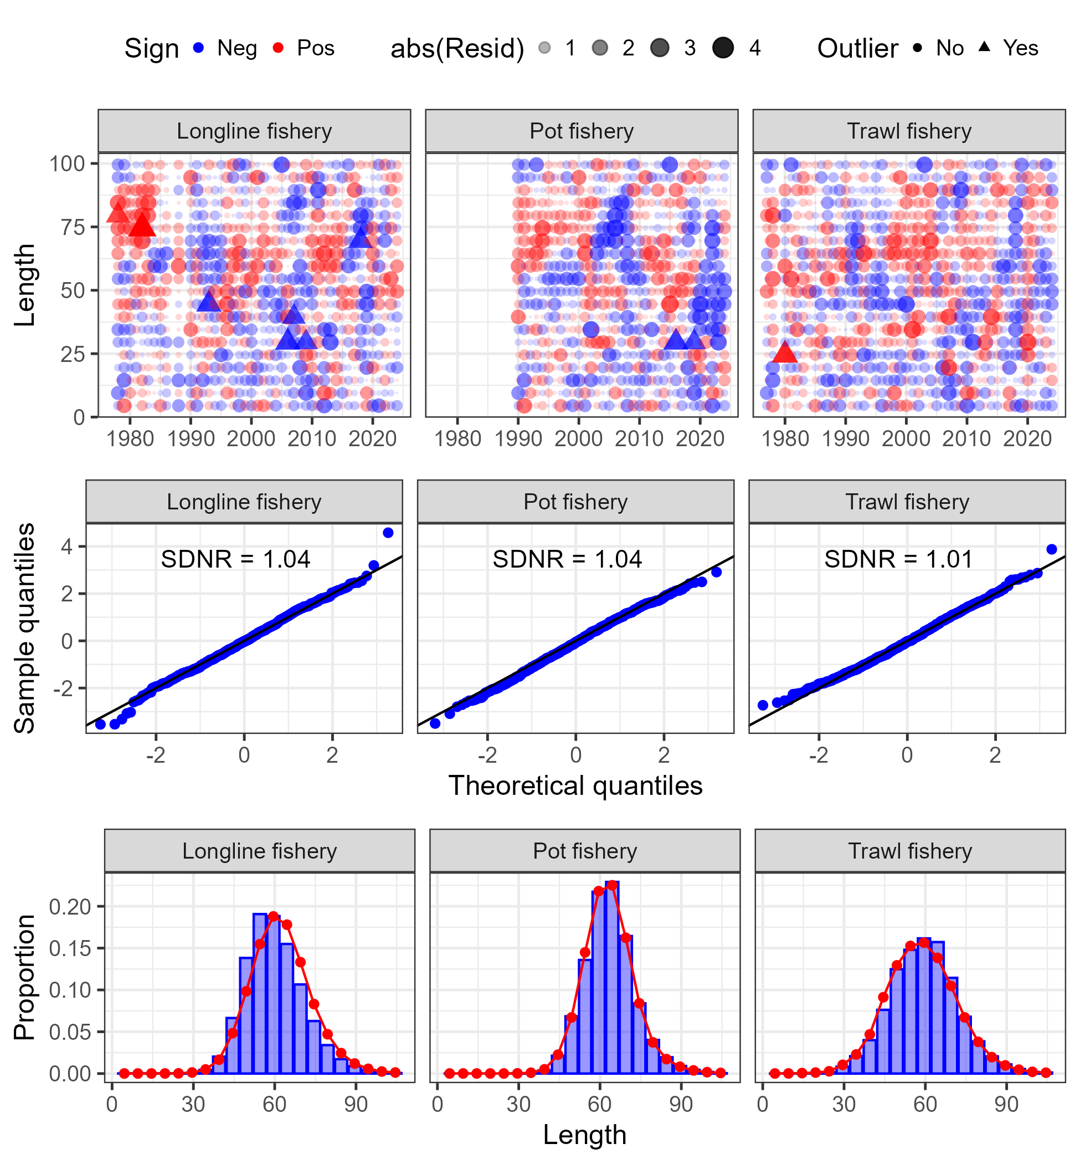
Results: data fits
No glaring sign of model misspecification in fit to fishery length composition

Slide 29
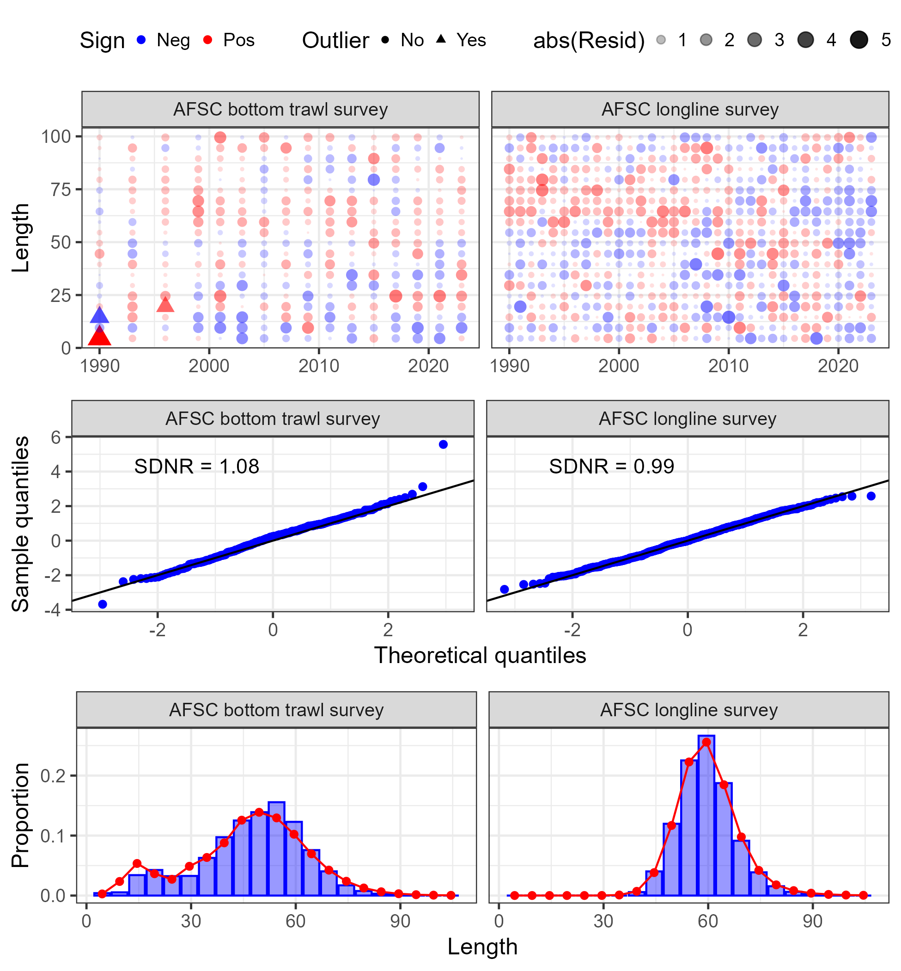
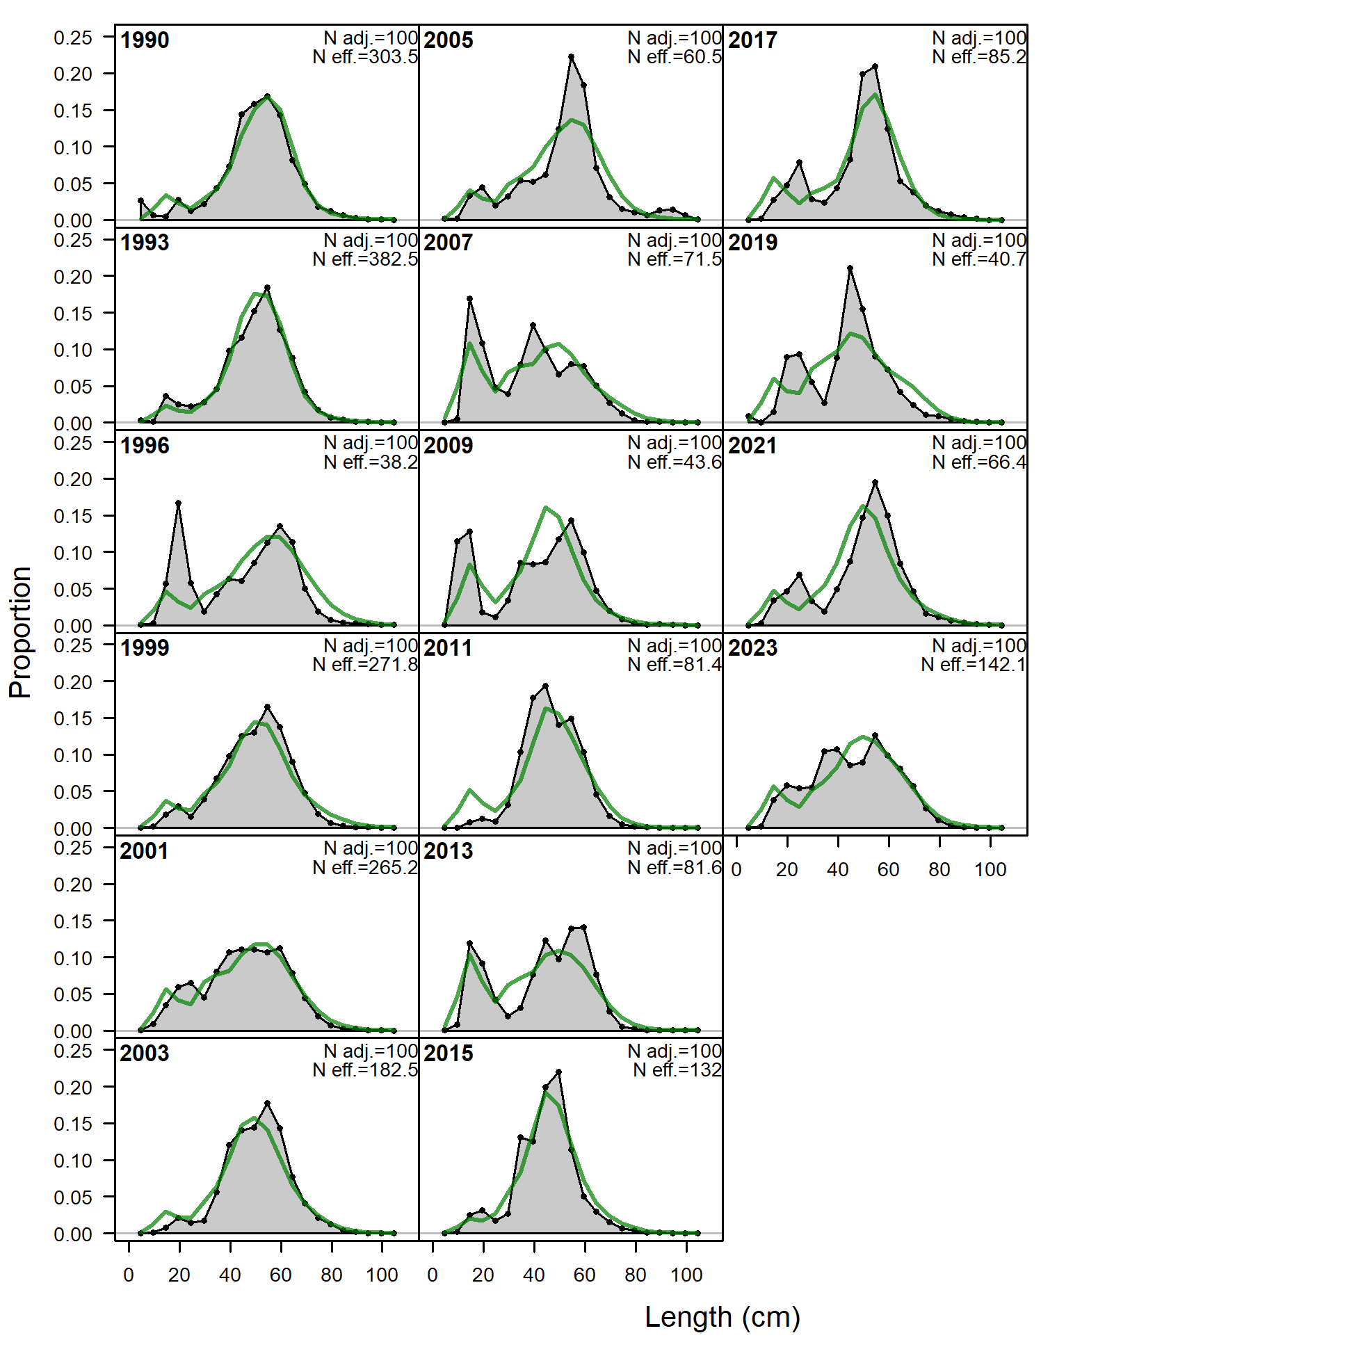
Results: data fits
No glaring sign of model misspecification in fit to survey length composition
But, some large residuals at smaller lengths in early trawl survey years and later longline survey years

Slide 30
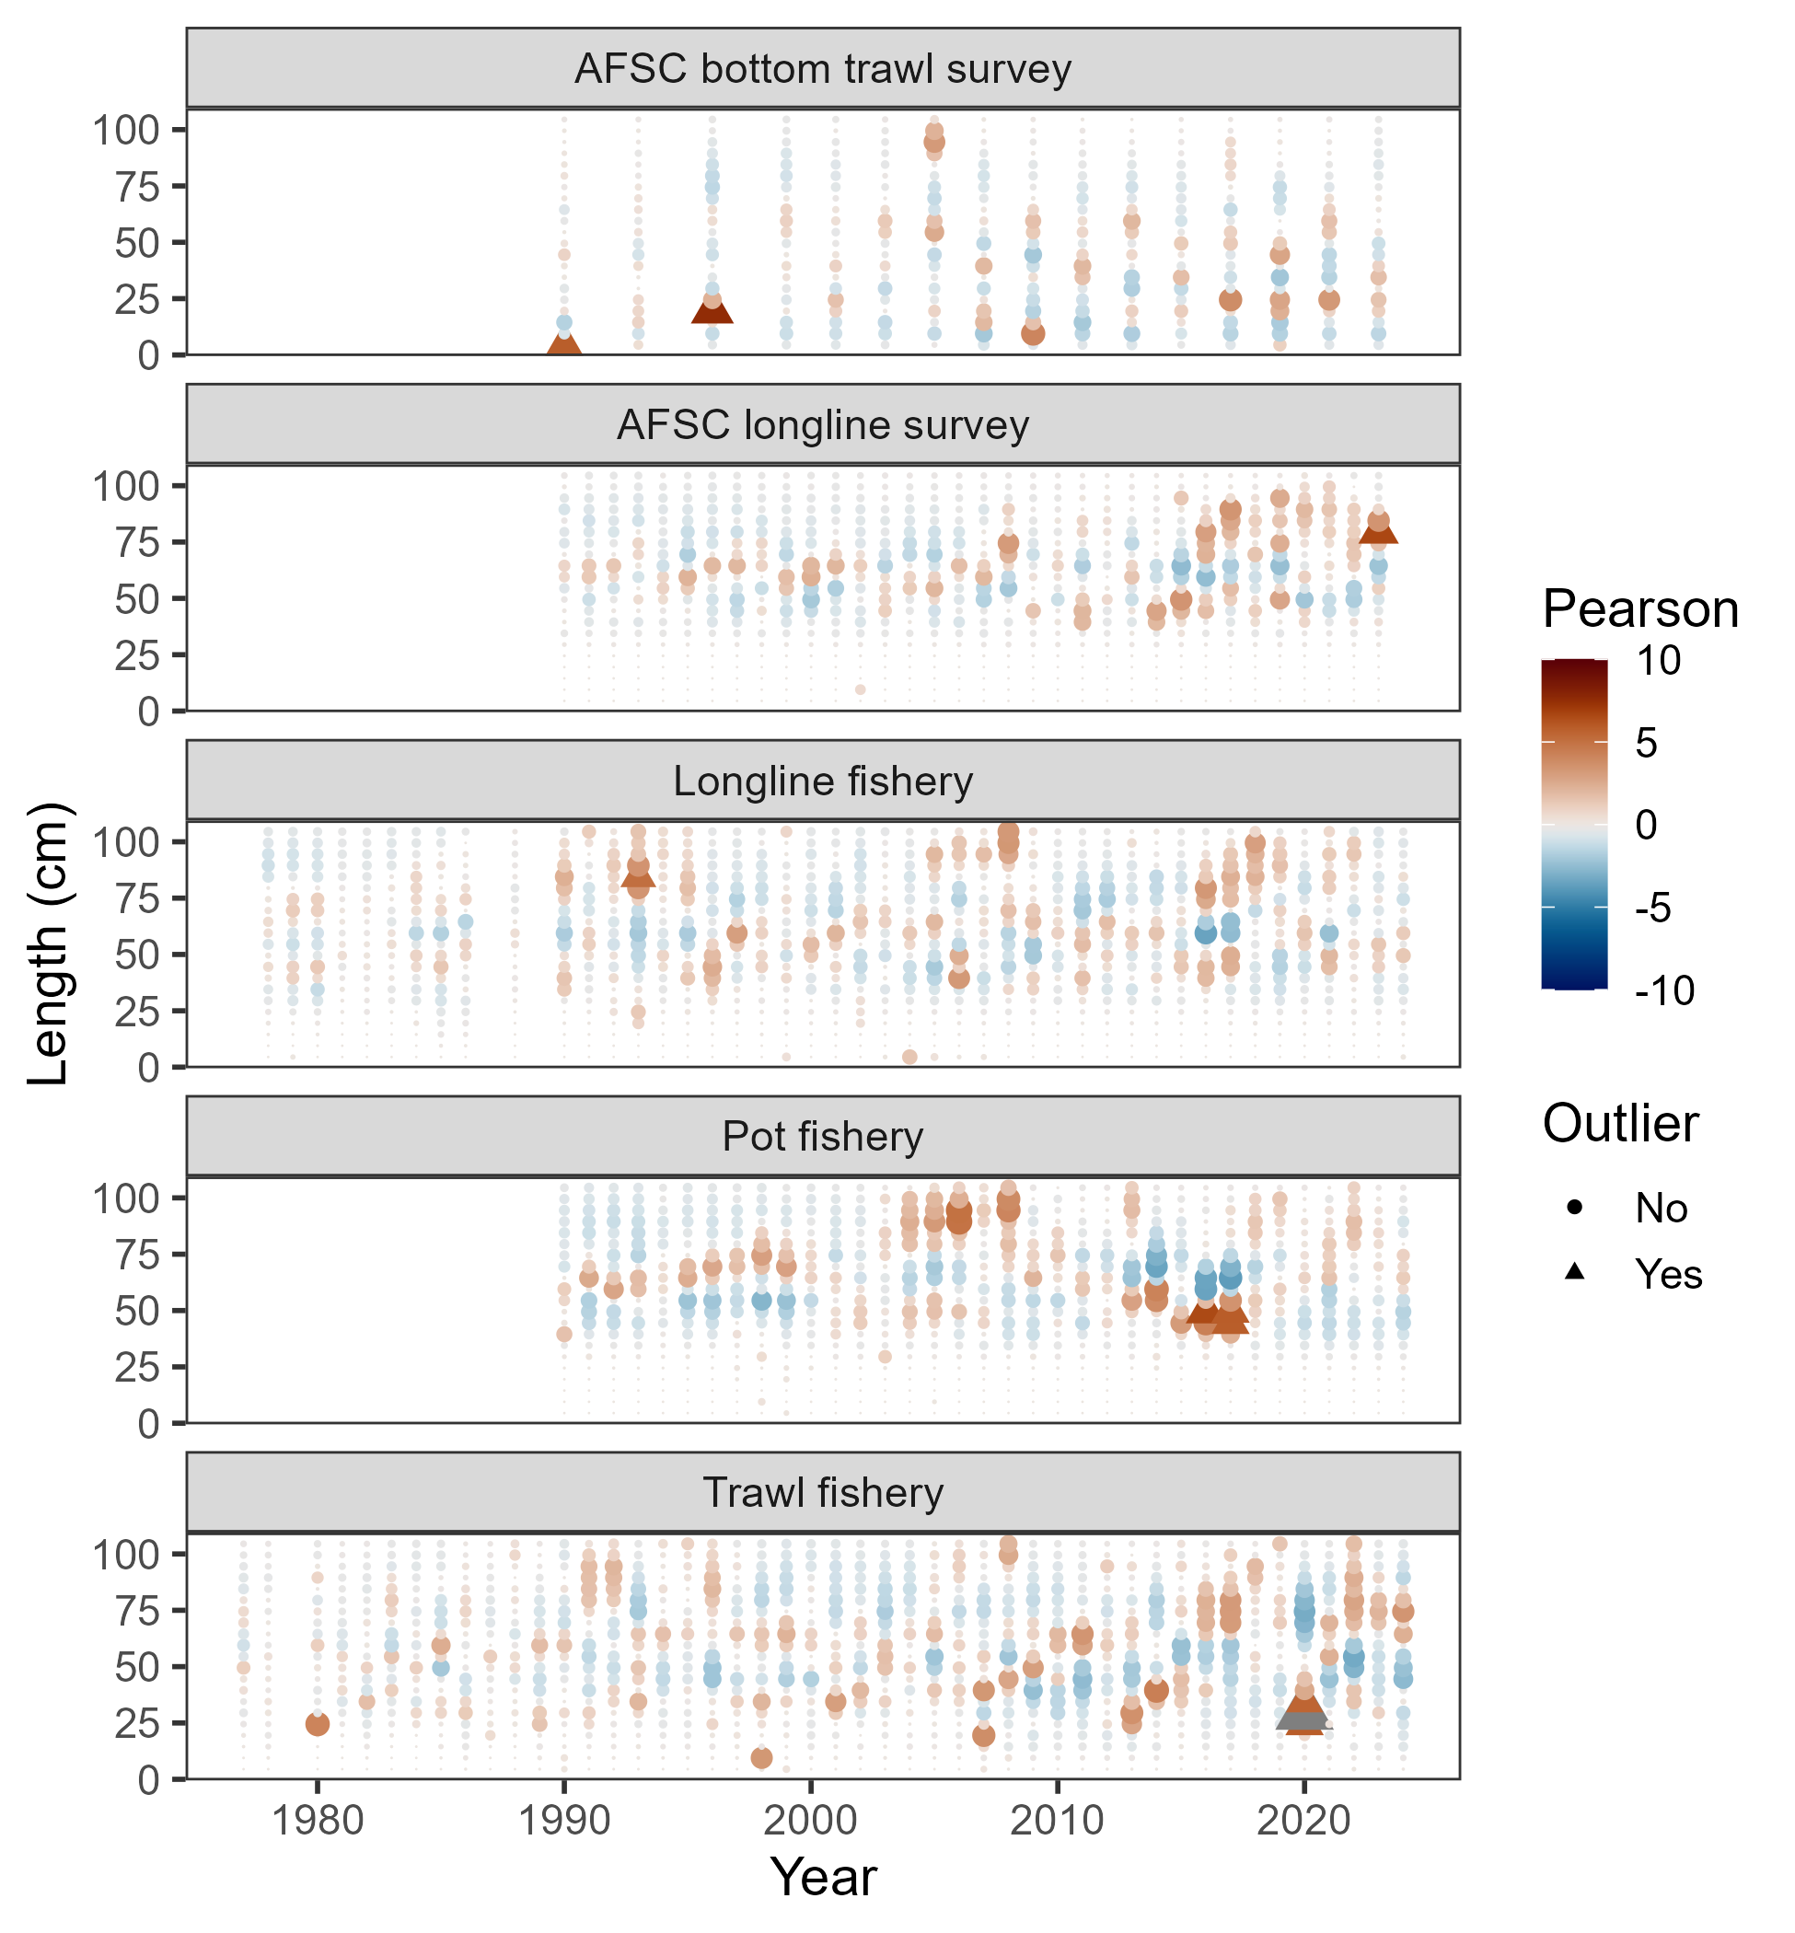
Results: data fits
Some large Pearson residuals reflected in OSA, some not

Slide 31
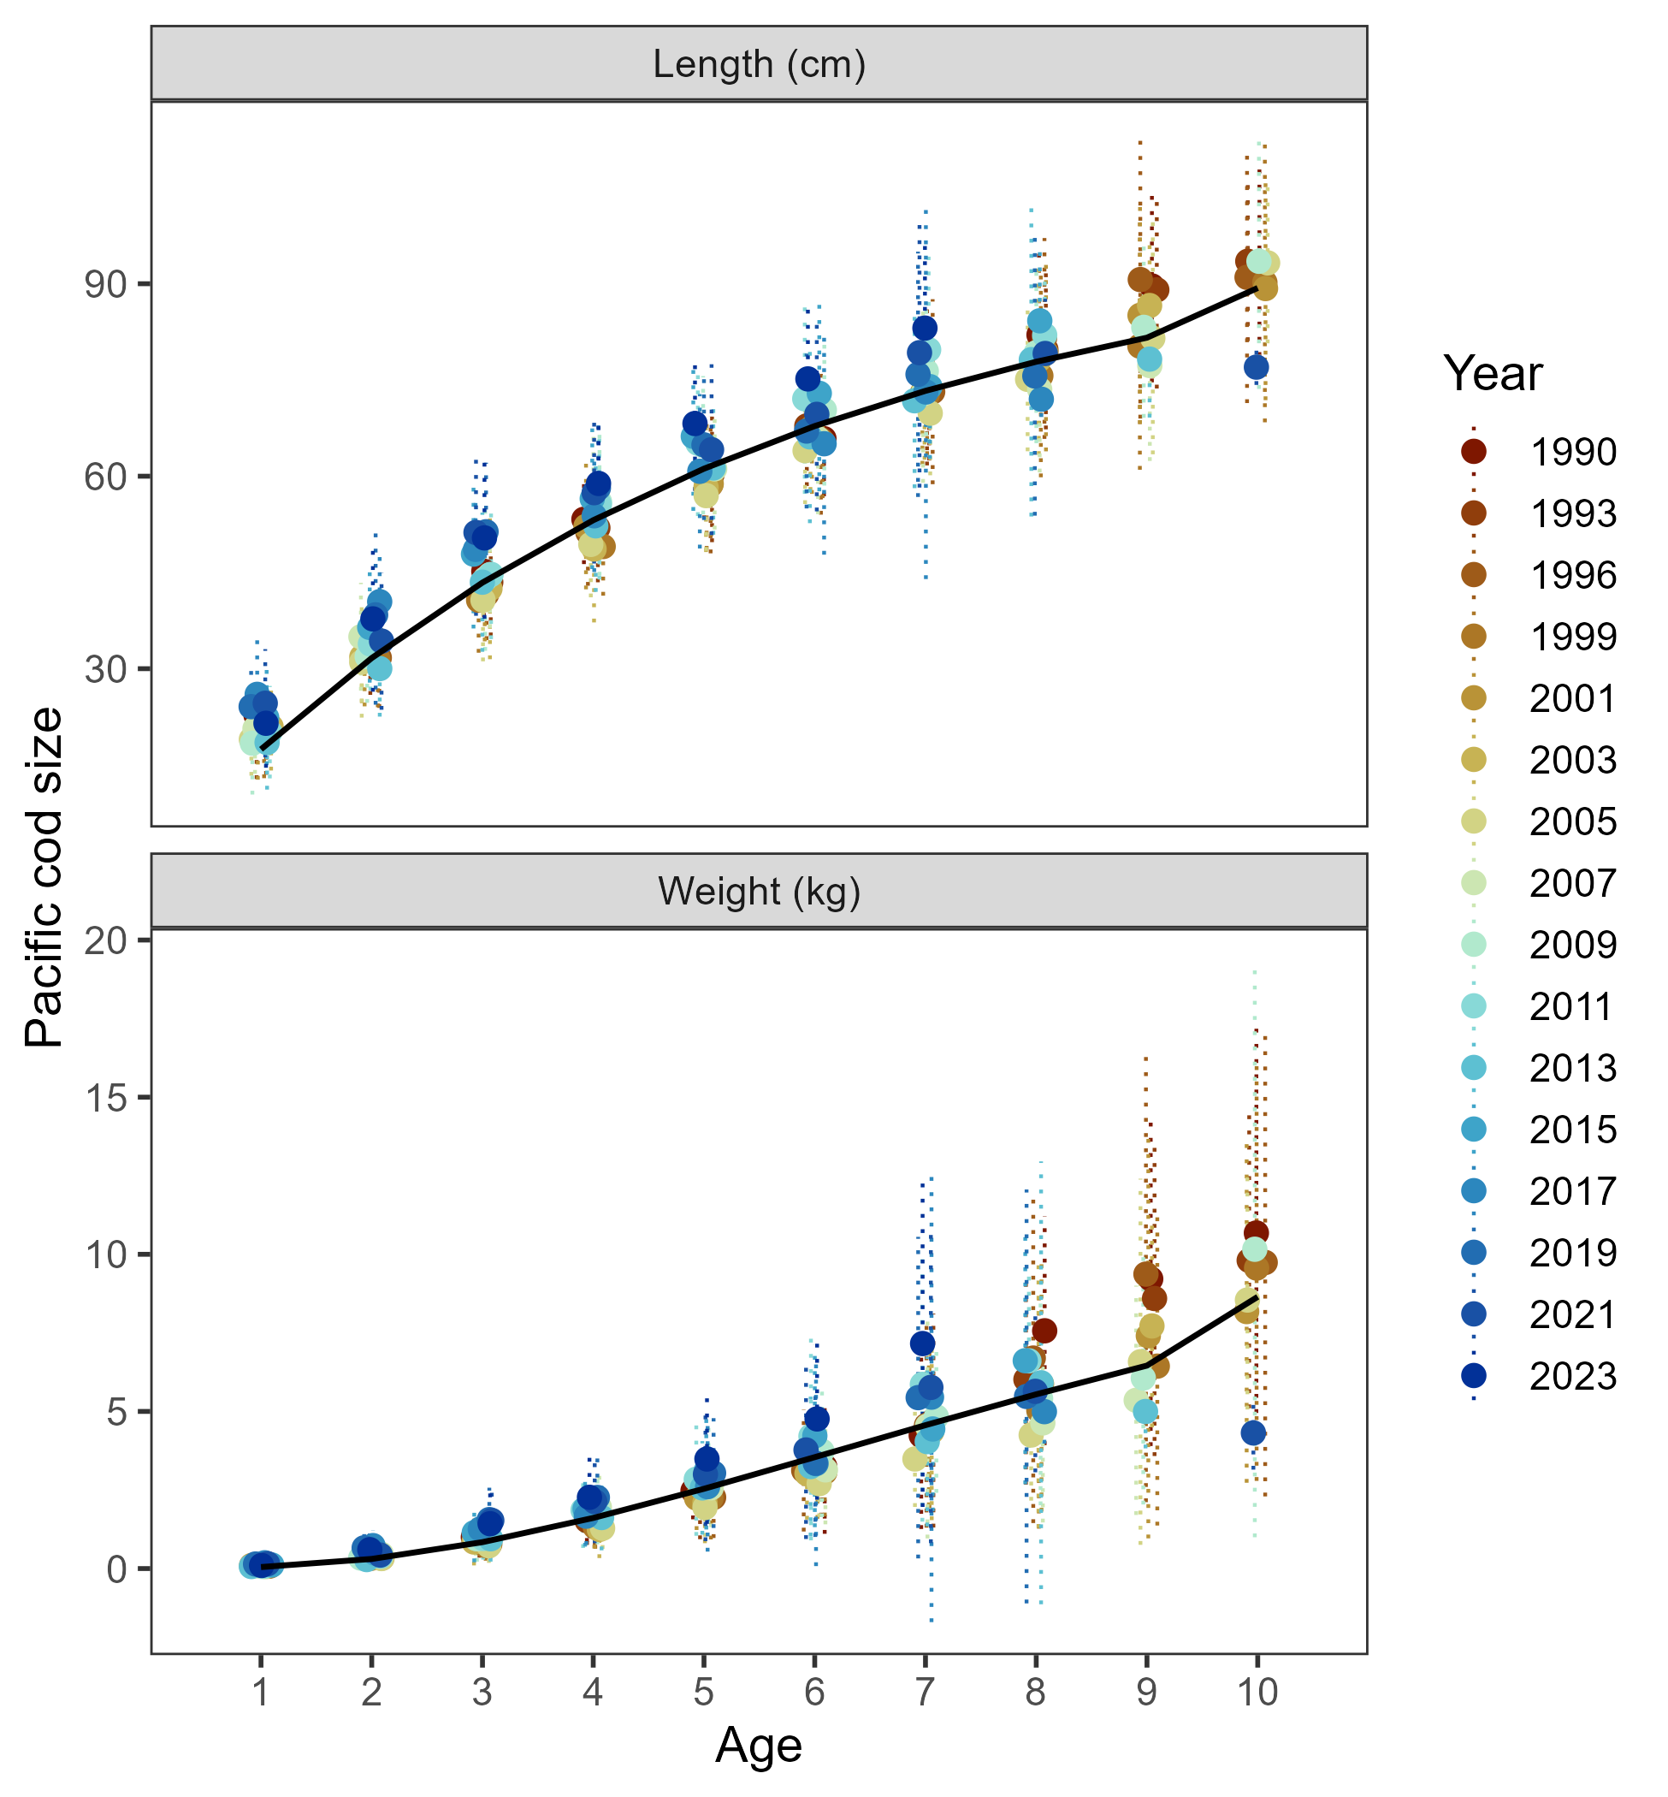
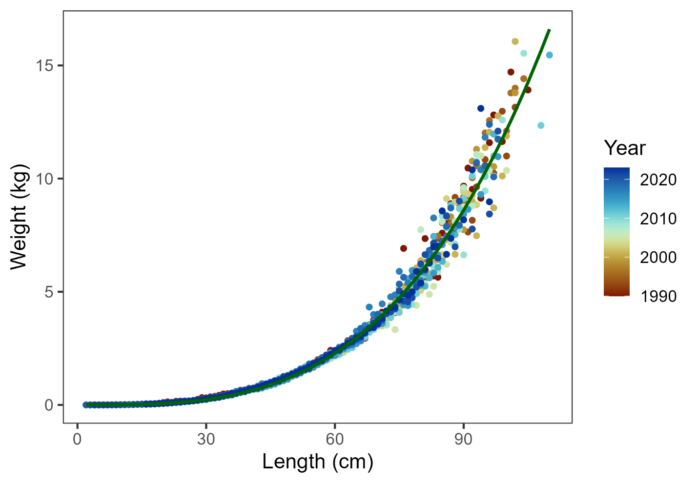
Results: data fits
Model estimates growth reasonably well, but…
Use beach seine length-weight data this year

Slide 32
Presented model diagnostics:
Retrospective: data and model
Leave-one-out: leave a year of data out
Add-one-in: add one new source of data at a time
Profile for key parameters
Other diagnostics:
Model convergence: final gradient was 6.57e⁻⁶, -no_hess ran with message “The fact this was successful gives strong evidence of convergence to a mode with quadratic log-likelihood surface.”
Jitter analysis: 50 at 5% CV, 44 converged, 78% to MLE
See in document:
MCMC: key parameter histograms, mixing, correlation
AFSC longline survey catchability sensitivity
Results: diagnostics

Slide 33
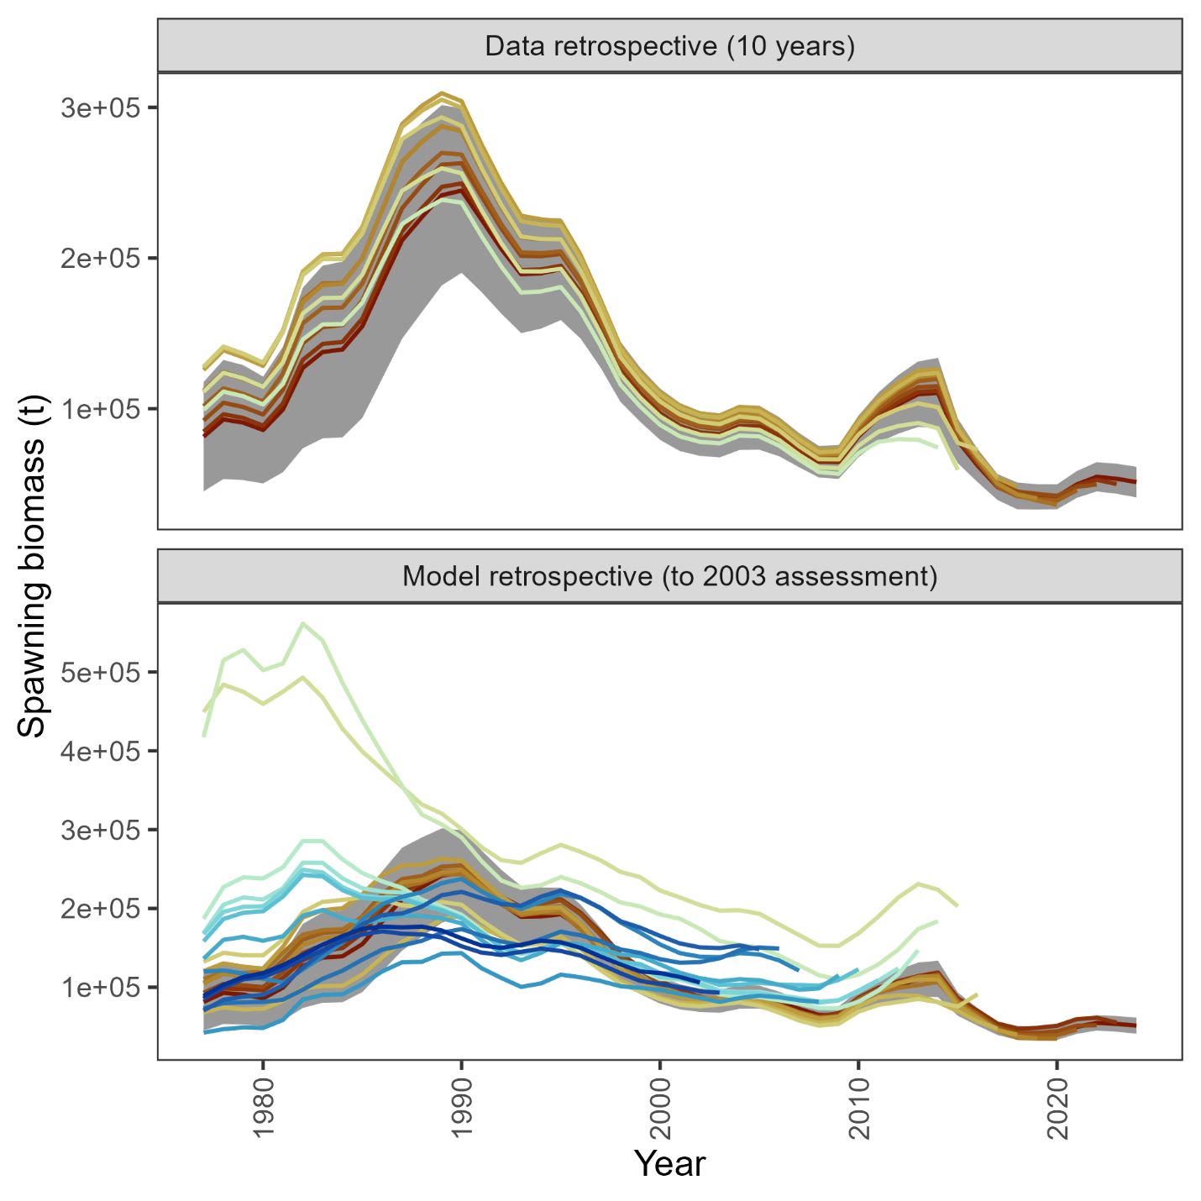
Data retrospective small & negative
Recent model retrospective consistent, but large retrospective pattern across models prior to 2015 assessment
Results: diagnostics

Slide 34
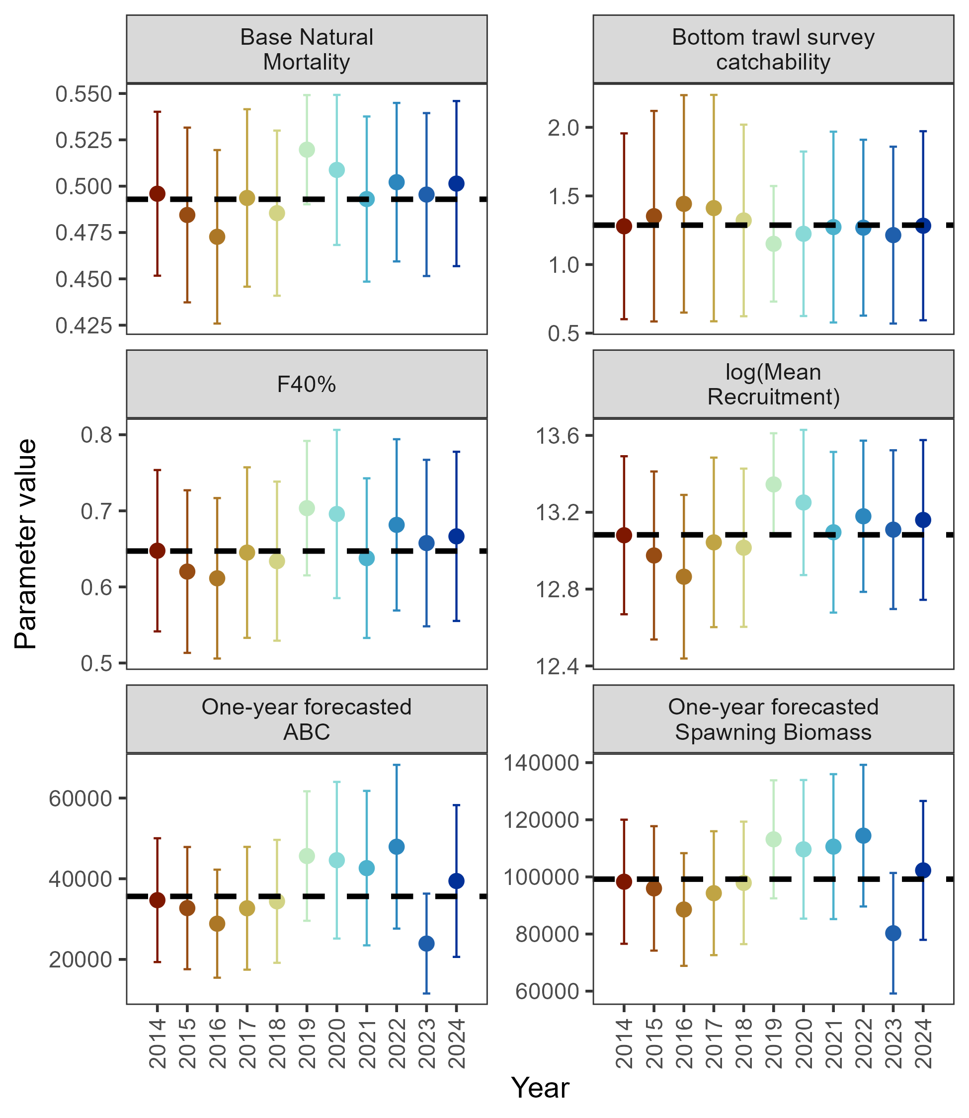
Leave-one-out: 2023 remains an influential year
Results: diagnostics

Slide 35
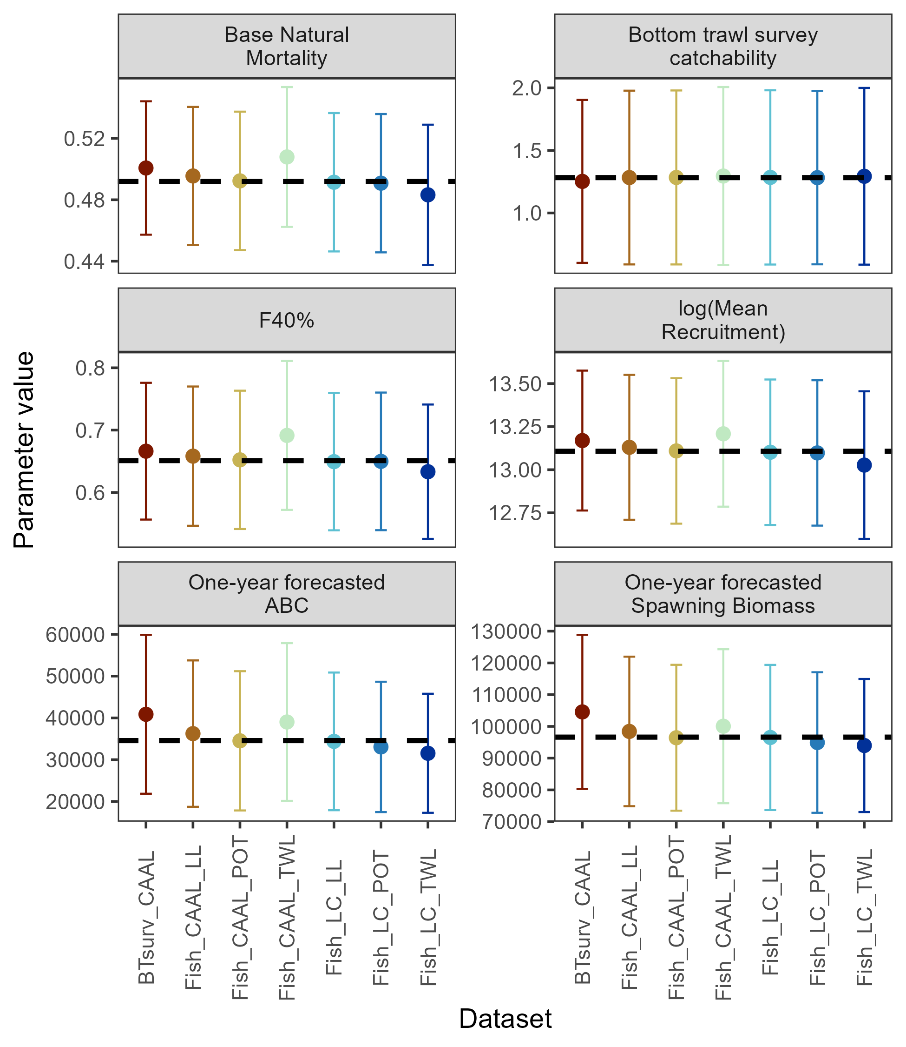
Add-one-in: 2023 AFSC bottom trawl survey and trawl fishery CAAL data influential on ABC, 2024 trawl fishery length comp to some extent
Results: diagnostics

Slide 36
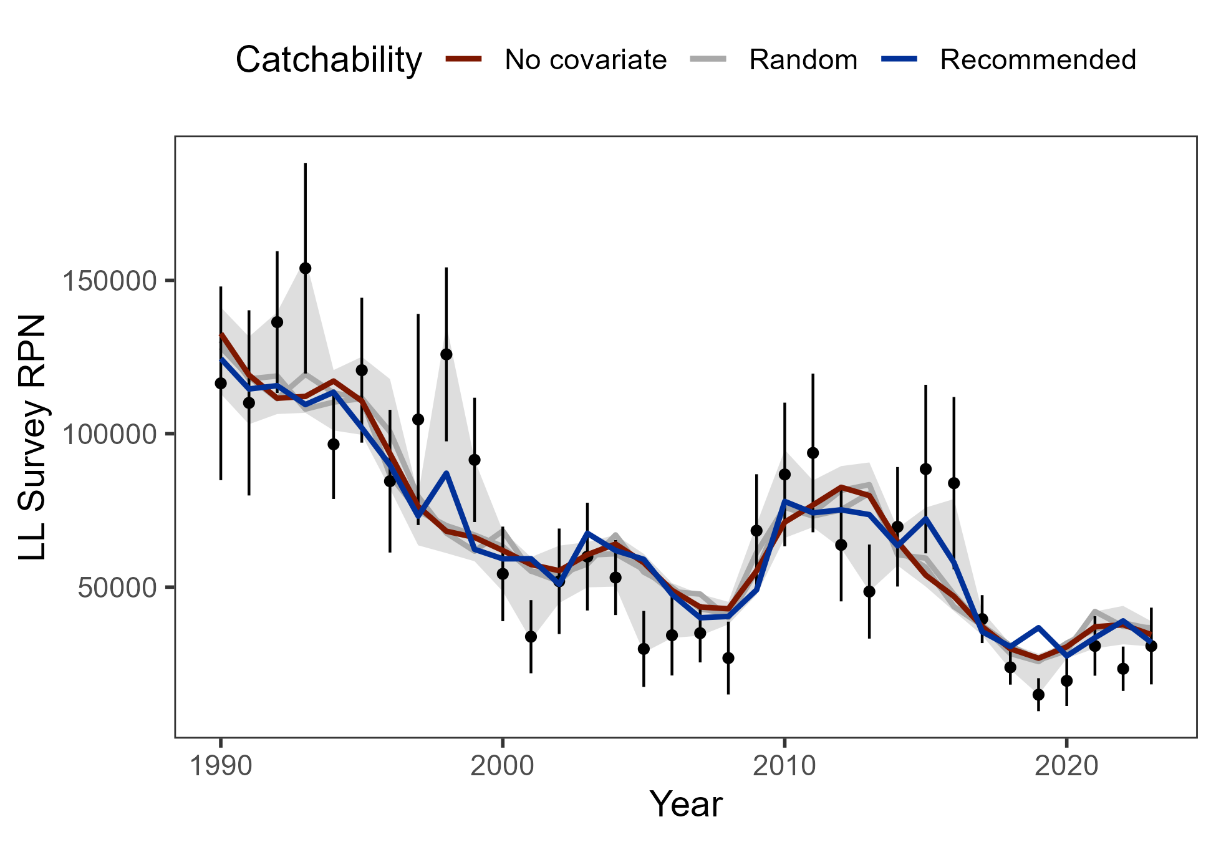
AFSC longline survey catchability sensitivity: Environmental link with CFSR remains preferred
Results: diagnostics

Slide 37
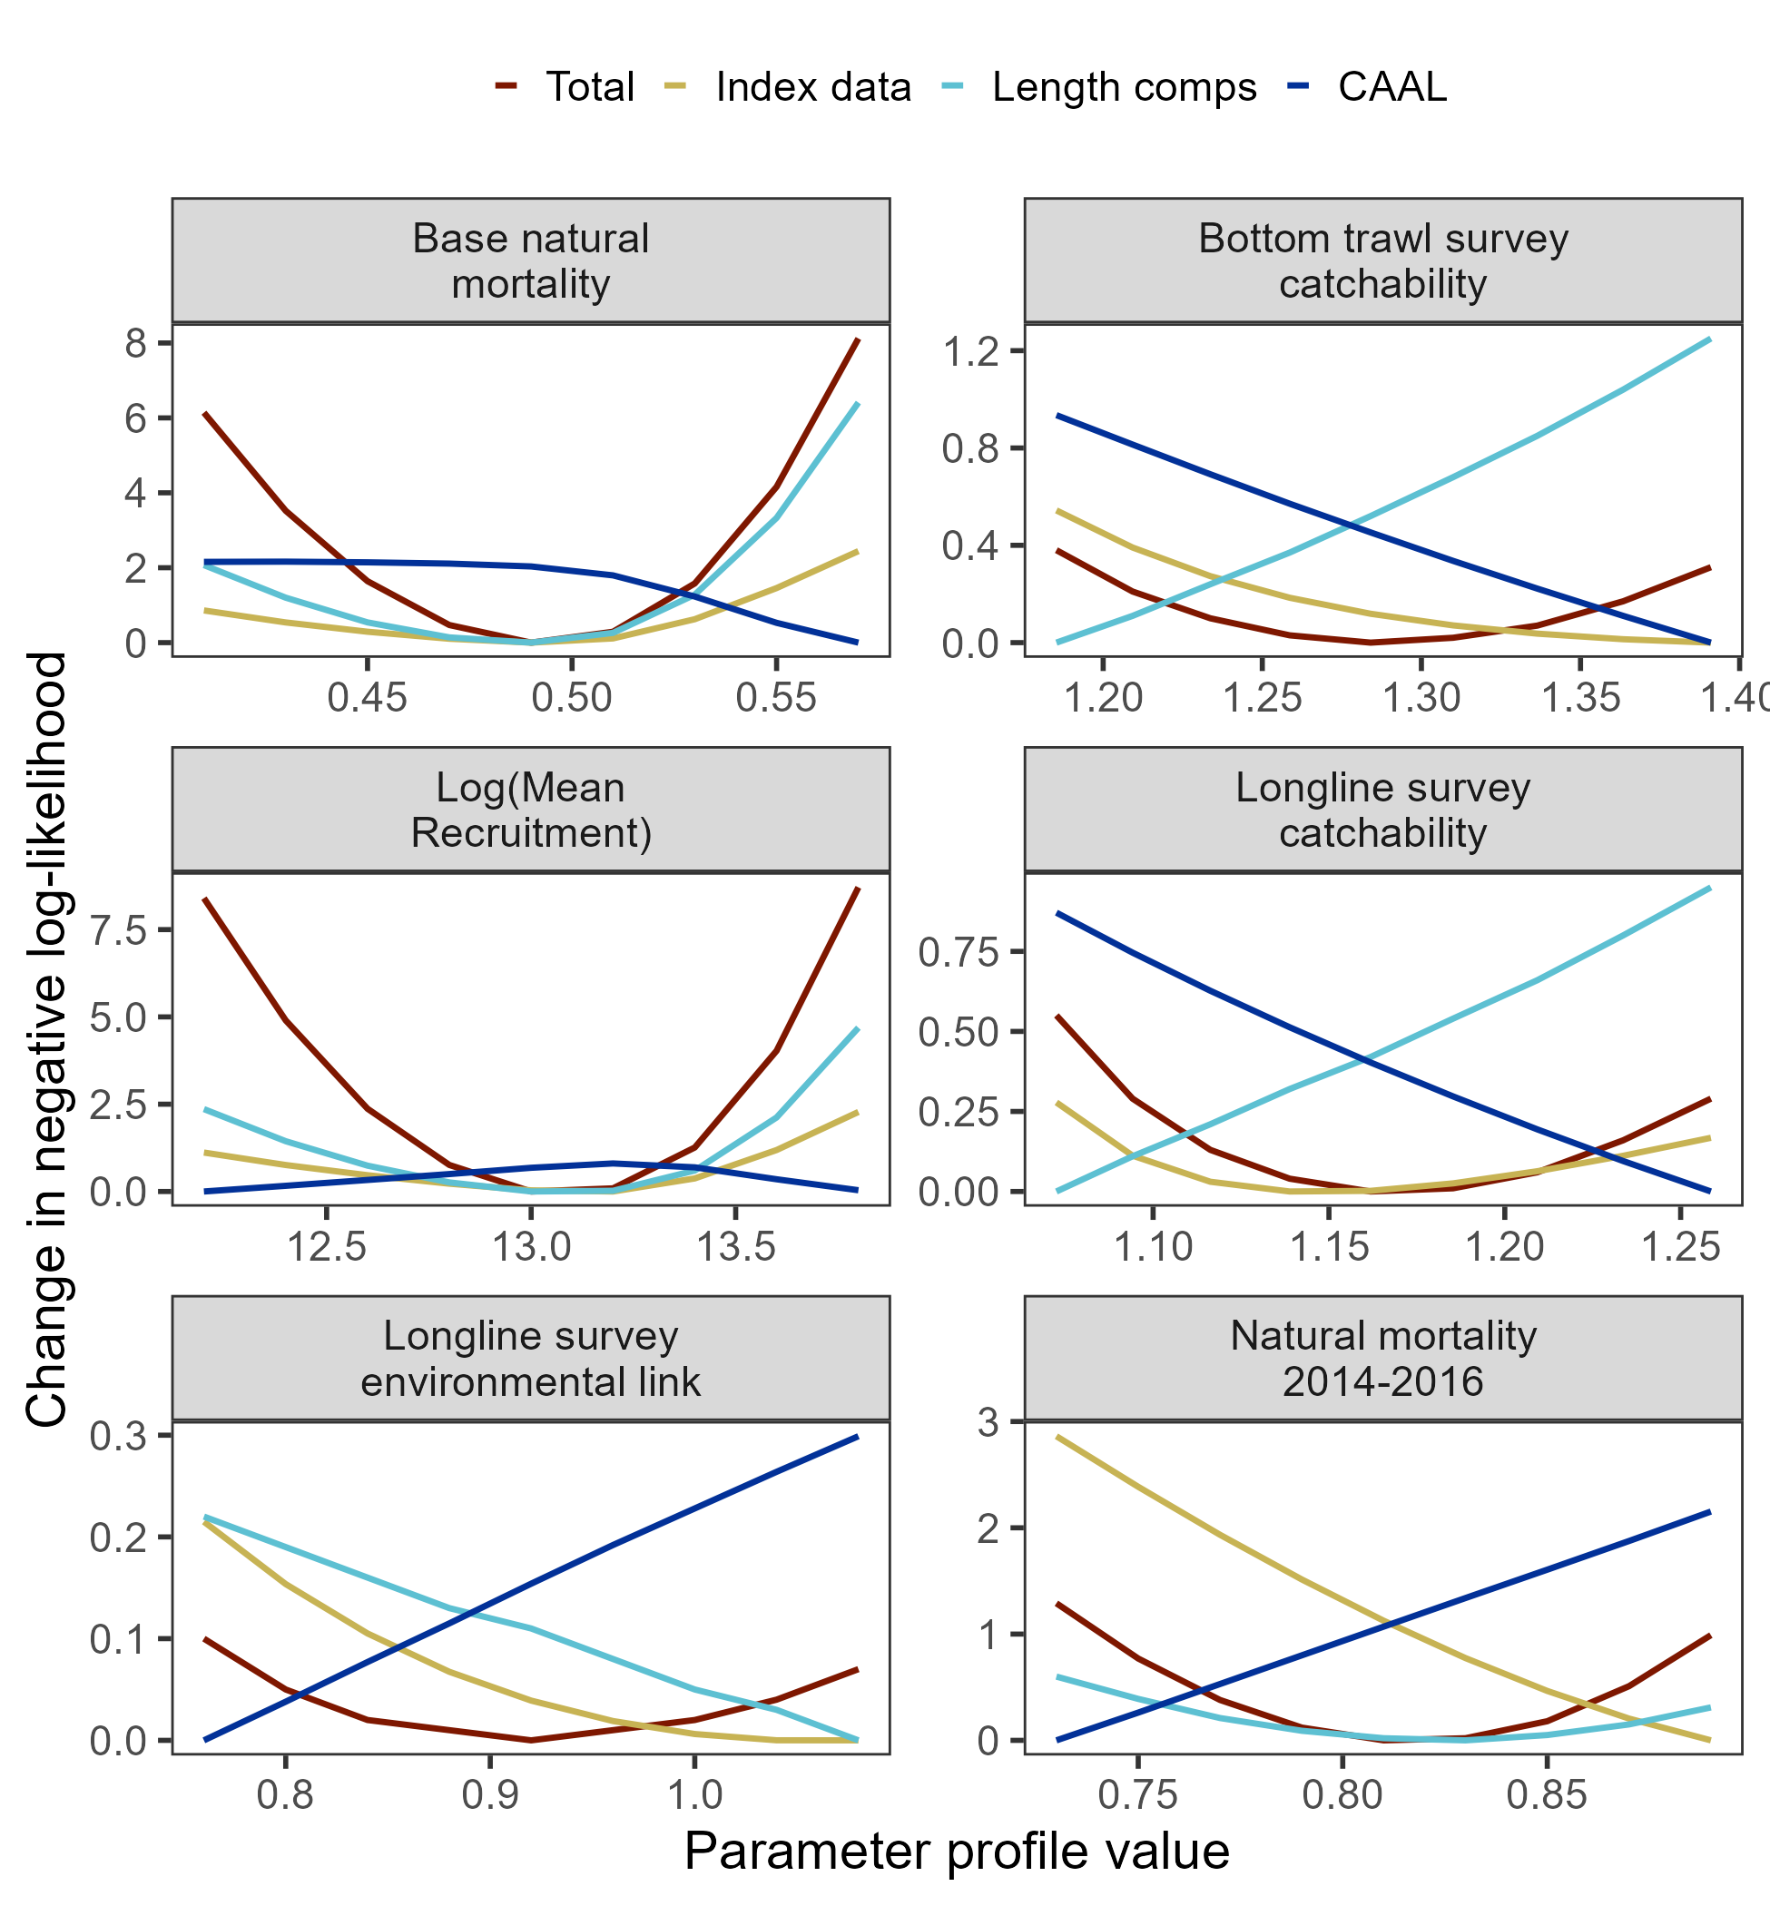
Parameter profiles:
Catchability: conflict between length comps and CAAL
Base M & lnR₀: minima confirmed by both length comps and index data
Results: diagnostics

Slide 38
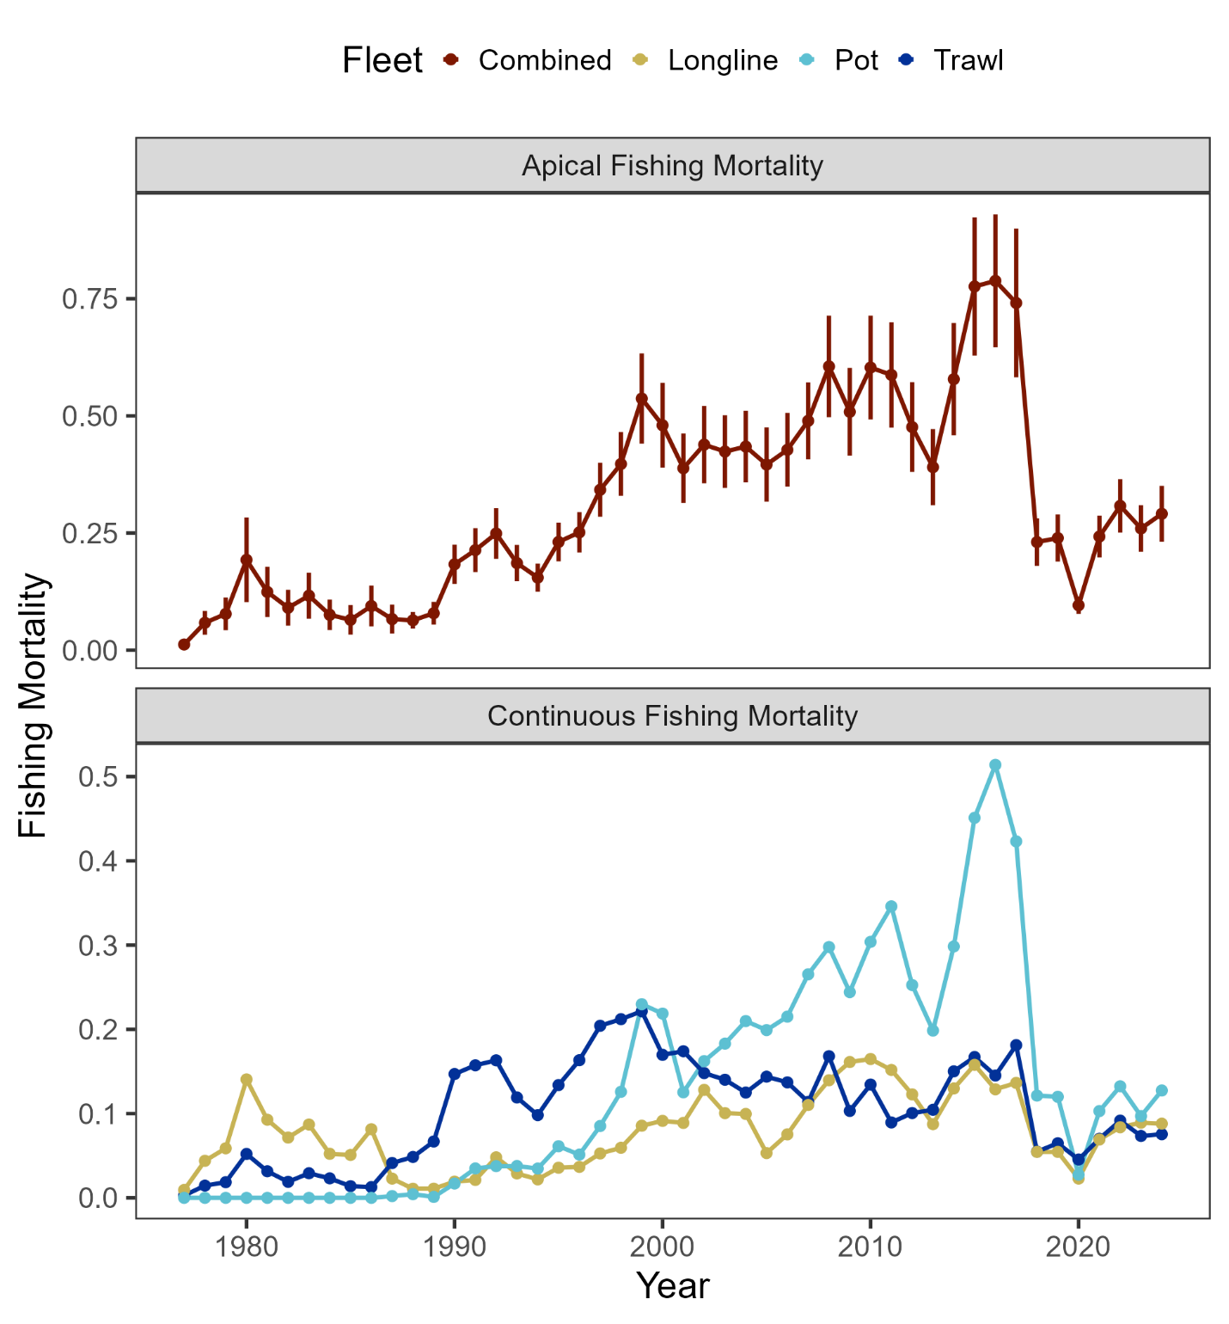
Results: parameter estimates
F staying consistent across last 4 years

Slide 39
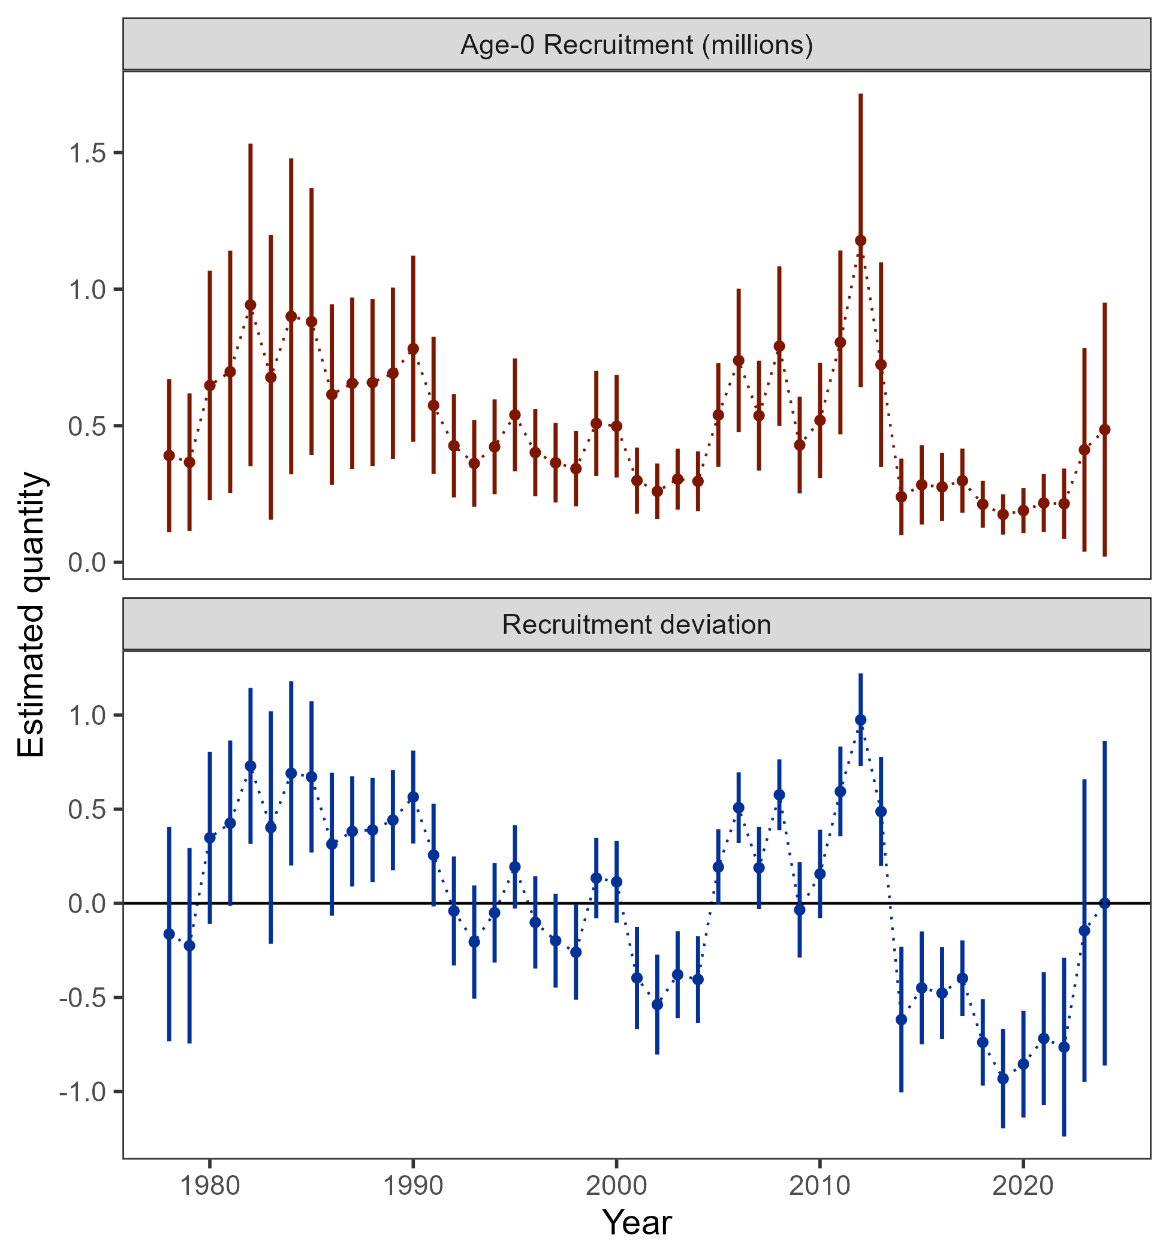
Results: parameter estimates
Below average recruitment since 2014 (following a stanza of above avg recruitment)

Slide 40
Results: parameter estimates
Name | Value | SD
Biology | -- | --
Beginning of year length at age-1 (cm) | 17.43 | 0.314
Beginning of year length at age-10 (cm) | 99.46 | 0.015
Growth rate | 0.19 | 0.002
SD in length-at-age for age-1 | 4.01 | 0.187
SD in length-at-age for age-10 | 8.99 | 0.345
Natural mortality (2014-2016) | 0.82 | 0.053
Natural mortality (all years) | 0.49 | 0.023
Recruitment/Abundance | -- | --
log(mean recruitment) | 13.09 | 0.213
1976 Regime adjustment | -0.68 | 0.19
Survey catchability | -- | --
Bottom trawl survey | 1.28 | 0.125
Longline survey | 1.16 | 0.108
Longline survey environmental coefficient | 0.94 | 0.411

Slide 41
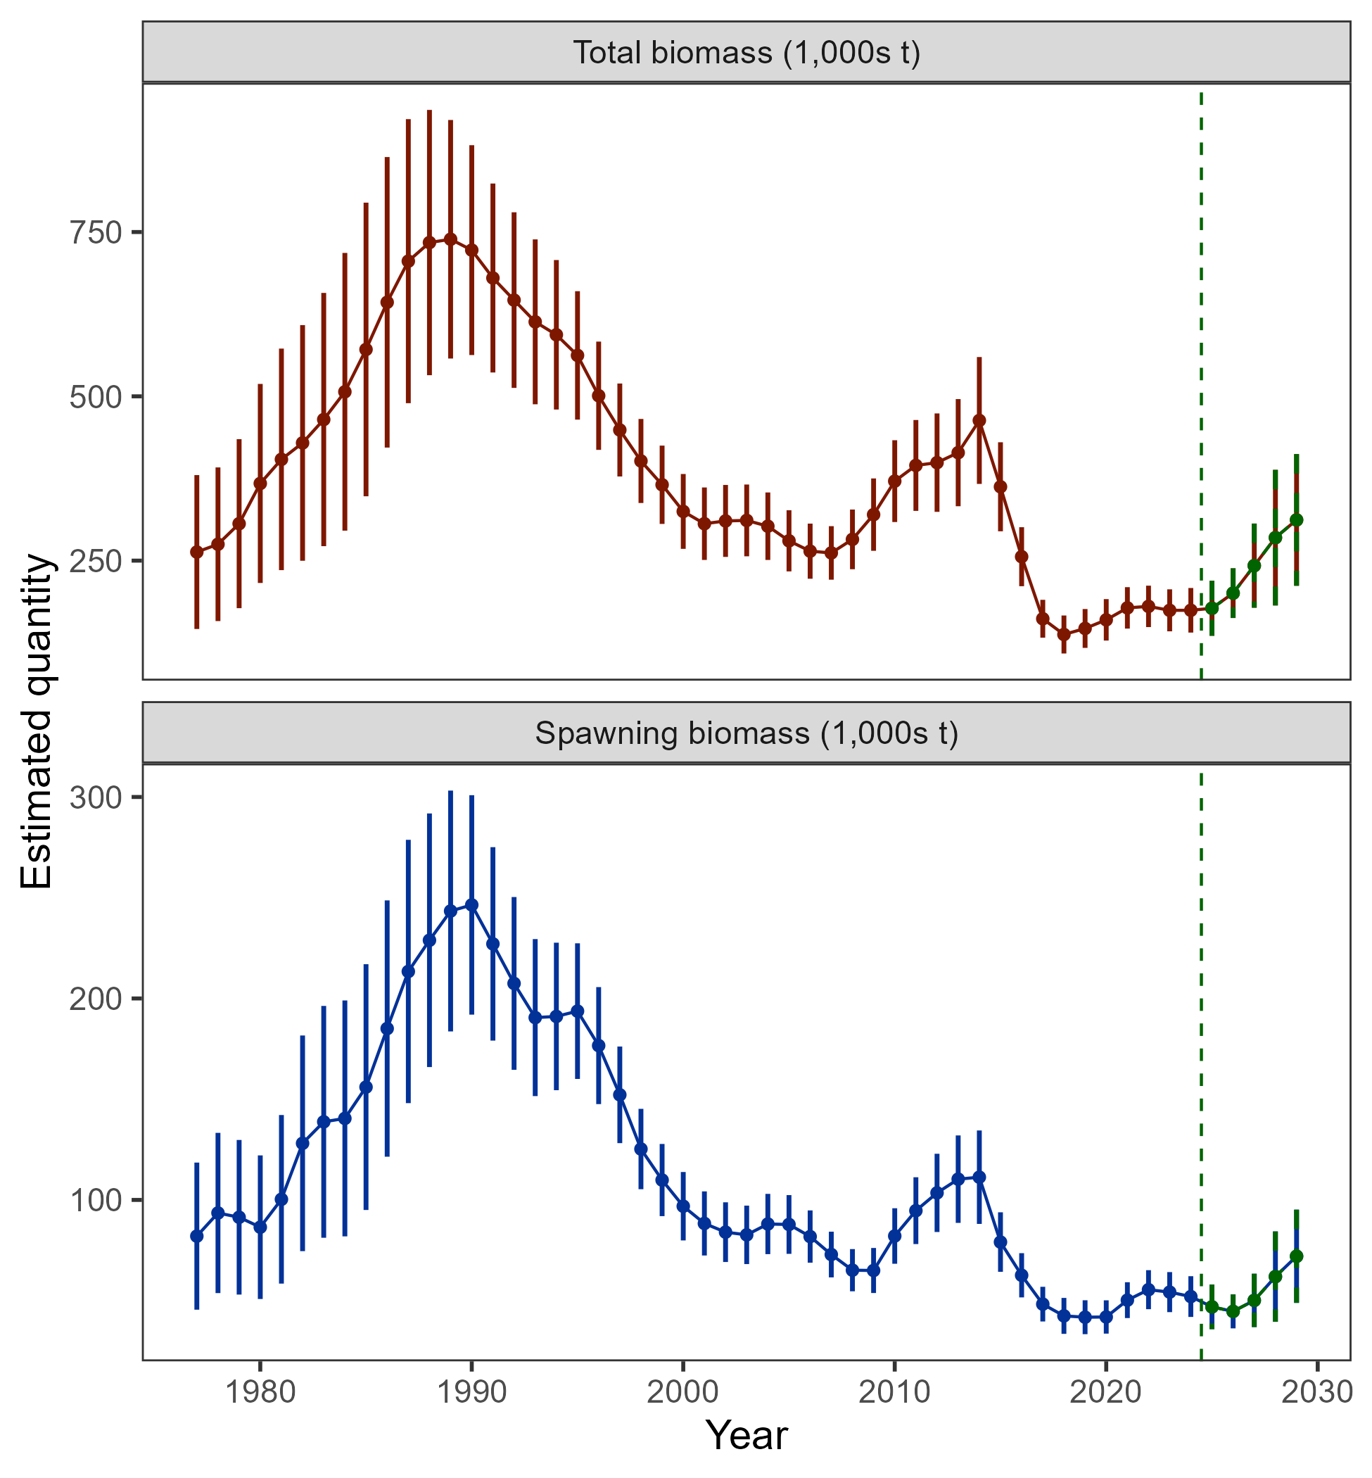
Results: time series
Biomass projected to increase, but, based on realization of average recruitment

Slide 42
Stock status
Risk table
ABC/OFL recommendations
Apportionment
Results: recommendations

Slide 43

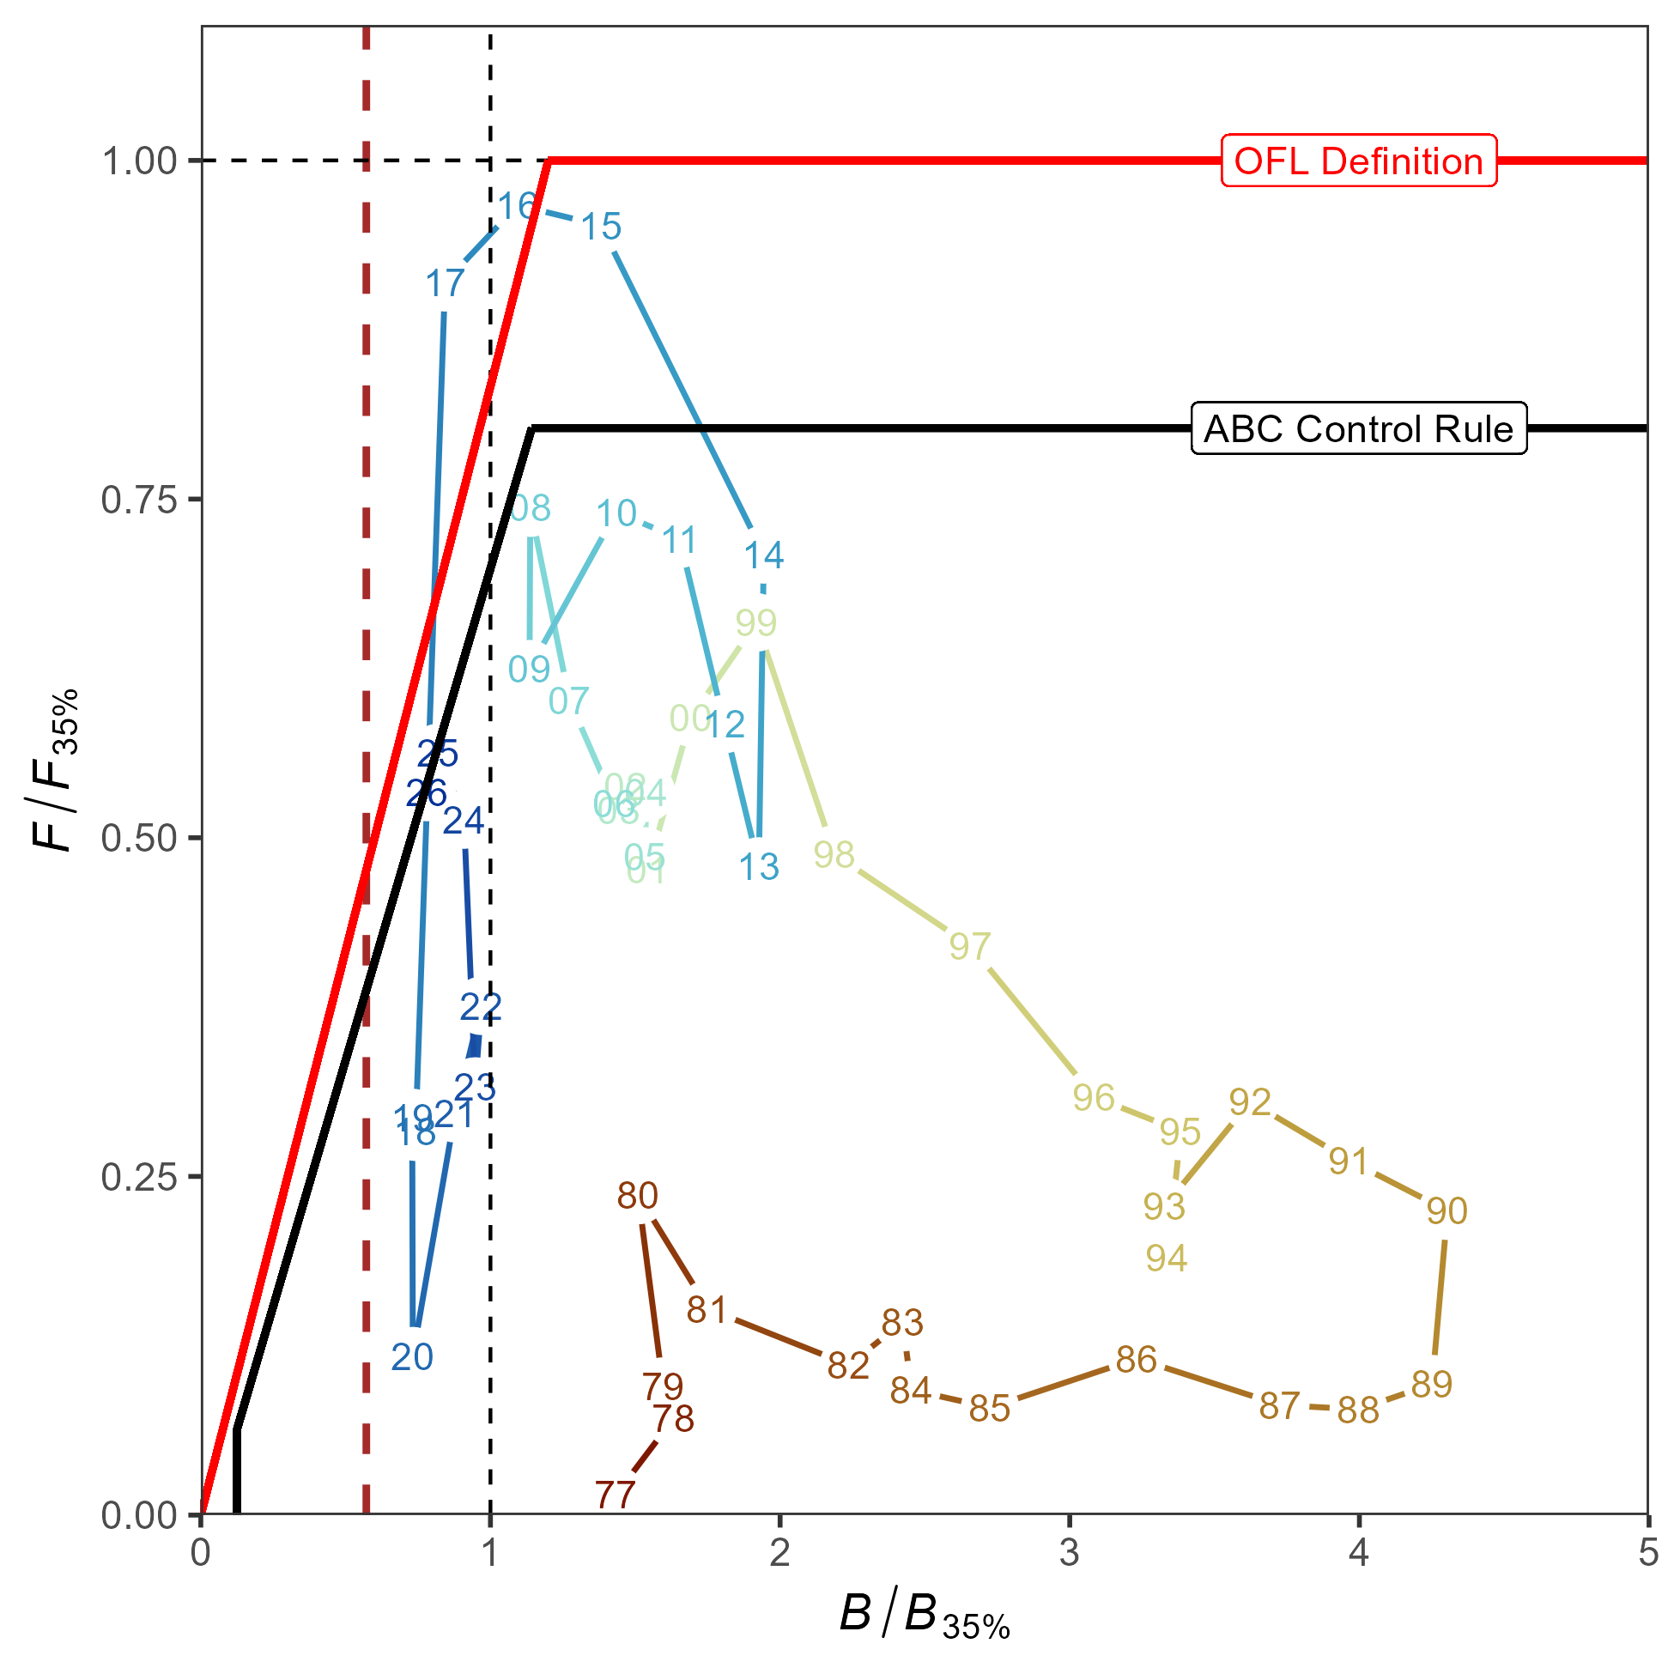
Stock status
Tier 3b: on the ramp
Estimated to be above B_{20%} (dashed red line), 2025 = B_{28.7%}

Slide 44
Risk table
Assessment considerations: Level 1
Pop dy considerations: Level 2 – will remain while population at low levels with added uncertainty as to how processes will respond to future environmental conditions (i.e., recruitment)
Environmental/ecosystem considerations: Level 1
Fishery performance: Level 1

Slide 45
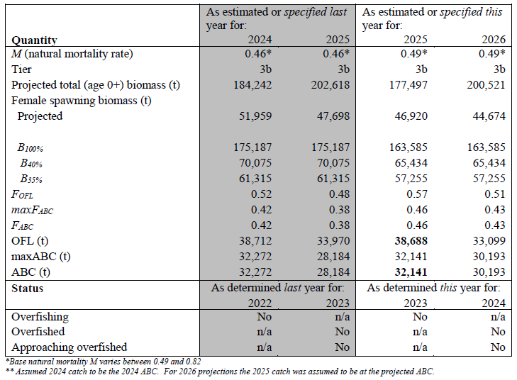
ABC/OFL recommendations
Recommend Model 24.0: <1% different than 2024 ABC

Slide 46
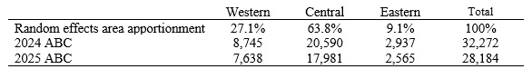
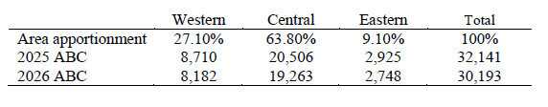
apportionment
Same as 2023, but with updated ABC

Slide 47
Current and Future work
Assessment to do:
Input sample size for comp data
Fishery & longline survey
Processes needing investigation
Selex & growth
What comp/other data & structure used?
Develop REMA with environmental link to scaling coefficient
Start looking at R-TMB
Port SAFE into RMD
Important consideration:
Maturity information update

Slide 48
Questions?

